Slide 1
CUFE PRESENTATION
University of Waterloo
Notes:
Presentation is focused on:
What/Who is Waterloo
How does the application/admission process work
How you can identify a Waterloo prospect
Waterloo’s expectations of our agents

Slide 2
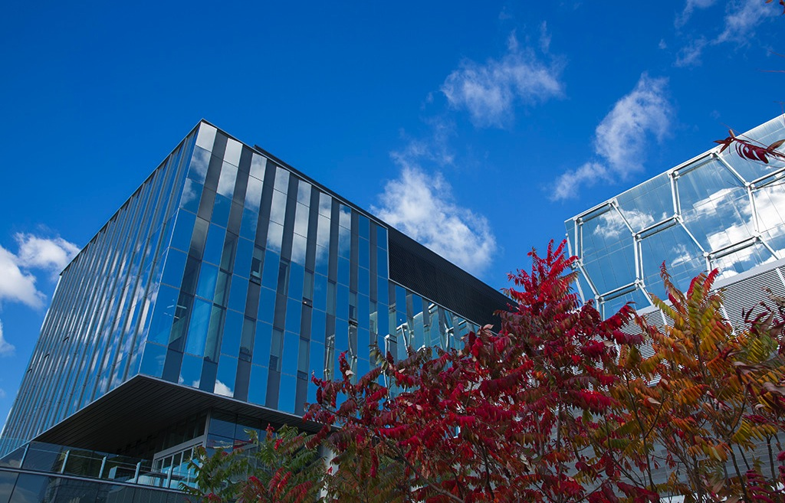

  WHAT IS WATERLOO?
  Canada’s most innovative university
  6 faculties, offering 100+ programs
  Very high entry standards
Notes:
Canada’s most innovative university
28000 undergraduates, 6000 graduate students
6 faculties, 100+ programs = diversity and specialization
Very high entry standards
Minimum 80%, many require 85-95% overall
Career-focused students
Self-contained campus within small student-friendly city known as Canada’s technology hub

Slide 3
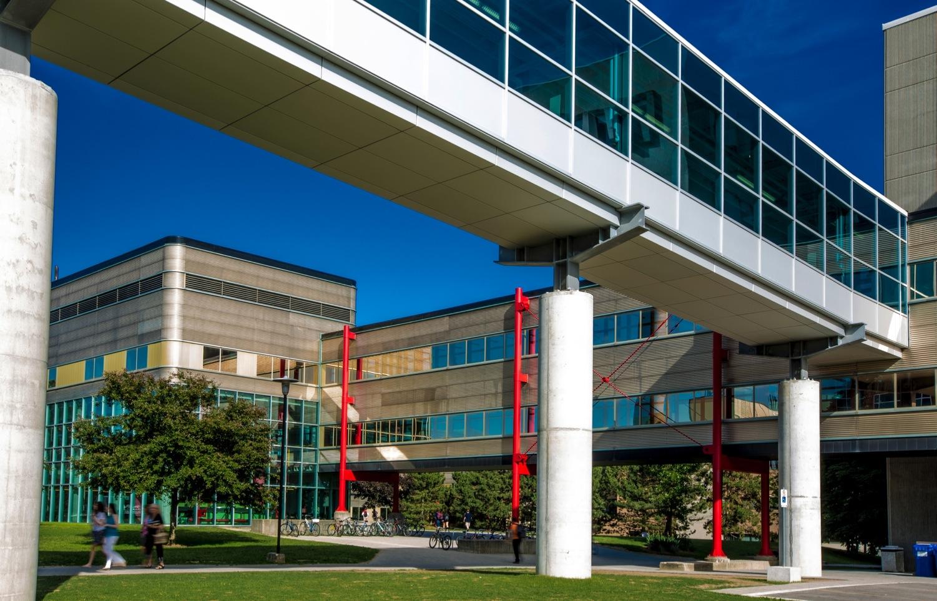
  WATERLOO’S STRENGTHS
  Academic excellence
  Research excellence
  Co-operative education
  Entrepreneurship
  Graduate success
Notes:
Follow this up with co-op video

Slide 4

  CO-OP AT WATERLOO
Co-op experience leads to stronger career prospects and higher starting salaries upon graduation
Notes:
Co-op = alternate 4-month terms of study and 4-month paid work terms
Up to 2 years of paid work experience
Potential earnings of $37000 - $77000
Opportunity to try various jobs and test variety of careers while completing the degree
Establish a network of employment contacts to improve career success
Co-op experience leads to stronger career prospects and higher starting salaries upon graduation

Slide 5

  APPLIED HEALTH SCIENCES
Assess, treat, and prevent illness and injury, and optimize quality of life
Good preparation for health professions
Notes:
Focus: assessment and treatment, preventing illness and injury, optimizing quality of life
Studying real-world problems in the classroom = graduates well-prepared for health professions or professional schools, such as medicine.
Key Programs:
Kinesiology: science of human movement, with a focus on four core areas: Biomechanics, Physiology, Neuroscience, and Social Sciences
Health Studies: Focus on the prevention of illness – proactive rather than reactive
Public Health: how to facilitate change in the social, political, environmental, and economic conditions that affect our health
Recreation & Leisure Studies: how health and well-being are enhanced through the effective use of leisure

Slide 6

  ARTS
Maximum flexibility with 24 majors
Interdisciplinary approach, e.g., Global Business and Digital Arts
Notes:
Interdisciplinary approach to research
social and applied science connections
Maximum flexibility in course selection and potential majors
24 different Majors grouped into Social Sciences, Humanities, Fine & Performing Arts, Languages & Cultures
Key programs:
Arts and Business
Accounting and Financial Management
Social Development Studies
Honours Arts
Global Business Digital Arts (relationship between content, business and technology and its application in digital economies)

Slide 7
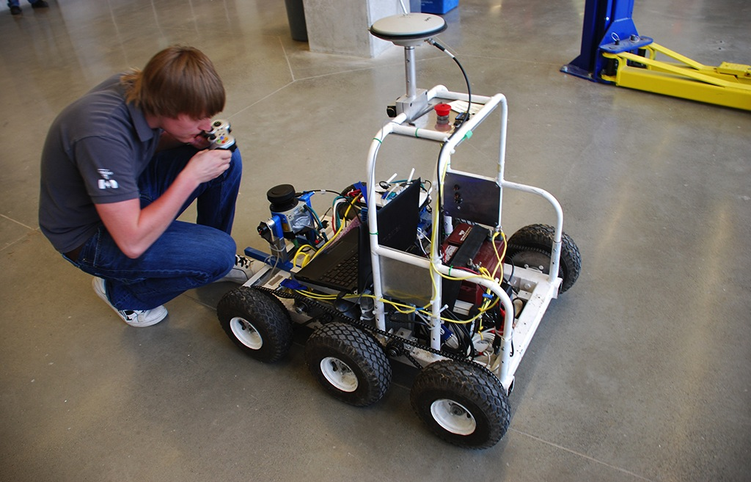
  ENGINEERING
100% co-op with exceptionally high entry standards
Origin of many start-up companies
Notes:
Largest in Canada, exceptionally high entry standards
Direct entry into specific branch (eg. Chemical) = supported smaller cohort + inventive design teams
100% co-op: immersive education = knowledge students learn in the classroom is strengthened with real-world experiences
Entrepreneurial focus: students innovate with novel ideas and incubate these ideas early in their careers
14 different branches of Engineering (includes Architecture)
Key programs:
Architecture
Mechanical Engineering
Civil Engineering
Chemical Engineering
Systems Design Engineering
Offers degrees in emerging multidisciplinary areas such as biomedical, mechatronics, nanotechnology, and environmental engineering
Strong reputation for leadership and innovation, with many start-up companies originating from Engineering students

Slide 8

  ENVIRONMENT
Focus on sustainability of human and natural environments
Unique programs include Geography and Aviation, Knowledge Integration
Notes:
Creates knowledge, nurtures learning, and promotes action to achieve sustainable futures in Canada and internationally
Focus on sustainability of human and natural environments
Key programs:
Environment and Business
Environment and Resource Studies
Geography and Aviation
Geography and Environmental Management
Geomatics
International Development
Knowledge Integration
Planning

Slide 9

  MATHEMATICS
World’s largest concentration of math and computer science talent
Strengths in actuarial science, statistics, financial analysis, math and business, computer science
Notes:
Largest concentration of mathematical and computer science talent in the world; breadth of choices; exceptionally high entry standards
Three entry points: Computer Science, Business and Accounting, and Mathematics
21 different program majors
Key programs:
Computer Science
Statistics and Actuarial Science
Mathematics, Business and Accounting
Pure mathematics
Combinatorics and Optimization
Advanced problem-solving skills applied to all areas of economy
Strengths in actuarial science, statistics, financial analysis, math & business, computer science

Slide 10
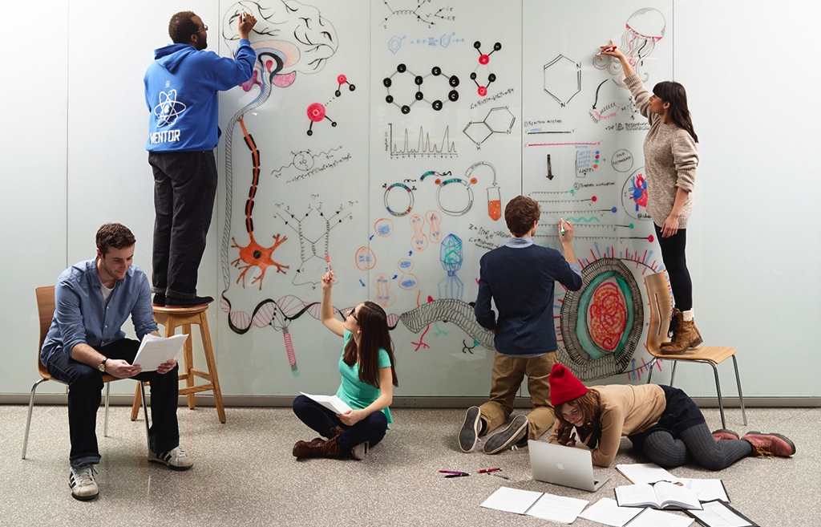
  SCIENCE
Broad offerings across life and physical sciences, plus innovative interdisciplinary programs
Notes:
Research focused studies with plenty of lab experience
18 different entry programs = ultimate degree customization, all leading to BSc
Key programs:
Biology
Chemistry
Earth and Environmental Sciences
Biotechnology/Economics and Biotechnology/Chartered Accountancy
Physics and Astronomy
Innovative programs combining science & business studies, science & aviation
Broad offerings across life and physical sciences

Slide 11

  BUSINESS PROGRAMS
Double degree programs
Accounting and Financial Management
“+ Business” programs
Notes:
Double degree programs
Math (BMath) & Business (BBA)
Computer Science (BCS) & Business (BBA)
Accounting & Financial Management
Professional designation for careers in public accounting, finance, industry, government
“X” & Business programs
Innovative blend of disciplinary expertise and full suite of business courses
More than 20% of Waterloo undergraduates are enrolled in a business or finance program

Slide 12

  ENTREPRENEURSHIP AT WATERLOO
Student + idea + Waterloo = innovation
Velocity Residence, Velocity Science, Greenhouse provide mentors and education
Notes:
Innovation: acting on an idea using Waterloo’s extensive support infrastructure
student + idea + Waterloo = innovation
Velocity
Residence
Velocity Science
Greenhouse (social entrepreneurship)
UW Entrepreneurship Society
Faculty mentors, industry role models
Courses, seminars, design projects, hackathons
Ideas Start Here video

Slide 13

  THE TYPICAL WATERLOO STUDENT?
  Hard-working • Independent • Smart
  Focused on my future career • Problem solver • Motivated • Don’t give up easily
Notes:
Waterloo students entering their first year of study describe themselves as:
Hardworking
Independent
Smart
Focused on my future career
Problem Solver
Motivated
Don’t give up easily
*refer to series of “why I chose…” videos on www.findoutmore.uwaterloo.ca

Slide 14

  STUDENT LIFE
A diverse, student-centered community
100+ culturally based, socially focused, personal interest groups
Notes:
On-campus residence guarantee in first year
9 different residence options; variety of styles
Includes meal plan (vegetarian, halal, vegan options)
Student services
Student Success Office, Health Services, academic advisors, tutors in residence, Centre for Career Action, Counselling Services, Federation of Students
Student clubs
Over 100 different culturally based, socially focused, personal interest groups
Athletic facilities
Fitness studios, intramural sports leagues, competitive teams, instructional courses
Waterloo = diverse, student-centered community
Wide variety of eateries, coffee shops, shopping choices, entertainment options, cultural & social events
safety & security
Waterloo, It’s My Home video

Slide 15
  ADMISSION REQUIREMENTS
Course requirements vary by program
  Grades
  Admission Information Form (AIF)
  English Language Requirement (ELR)
Notes:
Admission requirements according to various international curriculums are presented in the Appendix of the training guide

Slide 16
  REQUIREMENTS - GRADES
Grade 12
  Minimum overall average of 80% or above
IB Program
  Minimum 4, 5, or 6 in required courses
  Minimum total of 27-29
Recent cutoffs for Math/Engineering
  90%+
  IB – 35+
Notes:
Different course requirements by program
1. Grades: minimum Gr. 12 overall average of 80% and above
IB: minimum 4,5, or 6 in required courses (IB scores exclude Diploma points); total 27-29 minimum
Recent cutoffs: Math & Engineering: 90%+ (IB: 35+)
See Viewbook or www.findoutmore for specific details

Slide 17
  REQUIREMENTS - AIF
Contains details about student’s extracurricular activities & unique attributes
Explains special circumstances that may have affected student’s grades
Required for some programs, beneficial for all programs
Must be completed by student without agent assistance
Notes:
2. Admission Information Form (AIF)
Details about yourself, your extra-curricular activities, explain any special circumstances that may have affected your grades and/or which you would like taken into consideration during the admissions process
MUST BE COMPLETED ENTIRELY BY STUDENT WITHOUT AGENT ASSISTANCE
Required in some programs, beneficial in all programs
.

Slide 18
  REQUIREMENTS - ELR
English Language Requirement
  IELTS - 7.0
  TOEFL – 90/25/25
English Language Pathways (conditional admission) available
Notes:
3. English Language Requirement
7.0 IELTS, 90/25/25 TOEFL
English Language Pathways (conditional admission) available

Slide 19
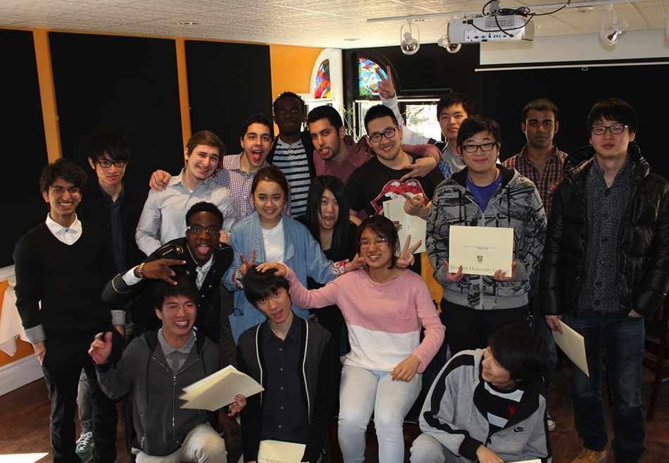
  ENGLISH LANGUAGE PATHWAYS
BASE and ELAS - for students who meet our academic standards and are slightly short of our English Language Requirement
Notes:
BASE: entry into programs in AHS, Arts, Environment, Engineering, Science
ELAS: entry into Mathematics
For students who meet our academic standards and are slightly short of our English Language Requirement (IELTS 7.0)
Conditional admission
automatic consideration upon application
pathways are not direct entry programs
1 or 2 terms depending on language test score
1 credit course + 3 English language skills classes
Support network of peer leaders, tutors, instructors
Full access to university facilities

Slide 20
Application process
All applications must go through Ontario Universities’ Application Centre (OUAC) www.ouac.on.ca
Include student’s email address if completing application with, or on behalf of, student

Slide 21
Application process – step 1
Deadlines for September 2016 intake
PROGRAM | APPLICATION DEADLINE | SUPPORTING DOCUMENTS
Most programs | March 31, 2016 | April 8, 2016
Architecture, Accounting & Financial Management | February 5, 2016 | March 1, 2016
Engineering, Software Engineering | March 1, 2016 | March 31, 2016

Slide 22
  APPLICATION PROCESS – STEP 2
Email confirmation sent from Waterloo upon receipt of application
  Directions to Admission Information Form
  Reminder of document submission deadline
  Instructions on how to access Quest for document upload
Notes:
Email confirmation with instructions comes within 2 weeks of application
- Supporting documents must include signed Privacy Release Form
Supporting documents can be uploaded into Quest and then original copies of documents must be mailed to Registrar’s Office
AIF should be written and submitted by all applicants (required in some faculties)
Student must complete the AIF entirely on their own with no assistance from an agent or any other individual

Slide 23
  APPLICATION PROCESS – STEP 3
Student must upload supporting documents electronically into Quest
  Original copies of the documents must then be mailed directly to Waterloo
  For agent confirmation/recognition: Privacy Release Form must be completed and signed by student and submitted to Brian Bailey (brian.bailey@uwaterloo.ca)

Slide 24
  APPLICATION PROCESS – STEP 4
Waterloo will review student file and make final decision on complete files only
Admission decisions appear in Quest
  Engineering makes bulk decisions in February, April, and May
  All other faculties make rolling decisions from January onward
  All final decisions made by May 15 each year

Slide 25
  APPLICATION PROCESS – STEP 5
Student must accept offer through OUAC and submit online residence application by June 1

Slide 26
COMPLETING AN APPLICATION
Application fee
  CAD $145 plus $85 Waterloo document
  assessment fee
  Student can apply to up to 3 choices or programs
  CAD $47 per additional choice
Notes:
Application fee: CAD$145 plus $85 Waterloo document assessment fee
Can apply to up to 3 choices/programs;
$47 per additional choice

Slide 27
  APPLICATION CONSIDERATIONS
  You may need to submit course syllabi
  We accept multiple applications and each receives a decision
  Regular vs. co-op – apply to a co-op program
  Arts programs are offered at multiple locations- apply to first choice
  Supporting documents must be uploaded to Quest and then originals sent to the University
Notes:
Application considerations:
Student’s contact information (email) must be included in all parts of the application
course syllabi (translated) for required courses must be submitted with grades for students studying in a National Curriculum school
Engineering: apply to preferred program and list 2 additional choices on Admission Information Form (AIF)
Architecture requires direct application
can apply to Architecture and another Engineering program.
We accept multiple applications – every application receives a decision
Regular versus Co-op: apply to co-op program
University Colleges: St. Jerome’s, Renison, and main campus all offer Faculty of Arts programs - apply to your first choice
Alternate admissions
When submitting supporting documents (grades, AIF, Privacy Release Form, ELR test scores), they must be uploaded into Quest and then original documents sent to University of Waterloo
Admission Information Form (AIF)
Must be completed entirely by student with NO agent involvement at all
Required for Engineering & Math; highly recommended for all others

Slide 28
  FEES AND SCHOLARSHIPS (2016)
PROGRAM/FACULTY | TUITION IN $CAD FOR FIRST 2 SEMESTERS
Applied Health Sciences, Arts, Accounting & Financial Management, Computing & Financial Management, Environment | $21,000
Mathematics, Science | $21,800-$22,600
Global Business & Digital Arts | $23,000
Architecture, Engineering, Software Engineering | $30,000-$31,000

Slide 29
  FEES AND SCHOLARSHIPS
Additional expenses:
  Incidental fees = $2,000
  Books & supplies = $2,000-$4,000
  Residence (including meal plan) = $9,200-$11,700
  Off-campus housing = $6,700
  Personal expenses = $3,000-$5,000
  Co-op Fees = $634/academic term
Notes:
Additional expenses:
Incidental fees = $2000
Books & supplies = $2000-$4000
Residence (including meal plan) = $9200-$11700
Off-campus housing = $6700
Personal expenses = $3000-$5000
Co-op Fees = $634/academic term

Slide 30
  FEES AND SCHOLARSHIPS
Scholarships:
  Automatic consideration based on admission averages
  Merit Scholarships: $1,000-$2,000 for first year
  President’s Scholarship of Distinction: $2,000 first year plus up to $3,000 in upper years
  Faculty Entrance Scholarships: $500 for first year to $80,000 for 4 years
Notes:
Scholarships:
Automatic consideration based on admission averages
Faculty Entrance Scholarships: $500 for first year to $80000 for 4 years
Merit Scholarships: $1000-$2000 for first year
President’s Scholarship of Distinction: $2000 first year plus up to $3000 in upper years

Slide 31
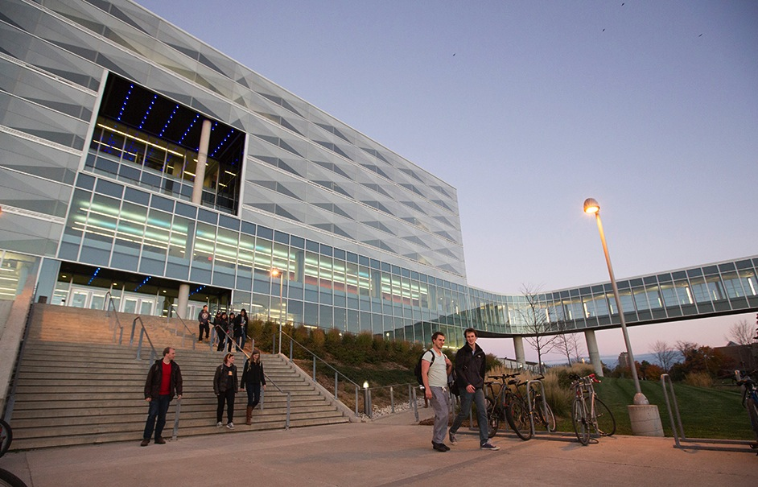
  WATERLOO’S OBJECTIVES
Target: 5 registered students a year
Open and productive relationships
Respect for, and protection of, our reputation
Regular, prompt, and consistent communication
Respect for Waterloo’s visit schedule
Notes:
Target: 5 registered students per year
Open and productive relationships which reflect our core values:
supportive mentorship, professional quality, respectful communication, creativity, positive energy and synergy
Network of local contacts who respect and protect our reputation
Innovation, unconventional, risk-taking, collaborative, critical-thinking, connected, courageous
Encourage regular communication
Provide prompt and consistent response to general admissions inquiries
The scheduling of Waterloo staff visits to a city/country is based on both school and agent visits
Waterloo staff will have full control over the nature and activities of local visit
Participation in agent fairs will be at Waterloo’s discretion
Agents must send notification of fairs to Waterloo
Any agent expenses on behalf of Waterloo must be pre-approved by Waterloo

Slide 32
  WATERLOO’S EXPECTATIONS
Raise awareness of Waterloo
Promote academic diversity beyond Mathematics and Engineering
Support prospective students through the recruitment and admissions processes
Attract the brightest and most motivated students – “average isn’t good enough”
Notes:
Raising awareness
attract exceptional students and support prospective students that have been developed by our recruiting staff
Qualifying applicants
vetting applicants to ensure admissibility
More quality applicants, not simply greater quantity
Academic diversity
applications beyond Engineering & Math
Brightest and most motivated students
position ourselves among the top 100 universities in the world
‘average’ isn’t good enough
Support students throughout Admissions process
Promote student self-sufficiency with agent support
Use www.findoutmore.uwaterloo.ca as a resource
At conclusion of slides, you may consider providing a tour of FindOutMore website

Slide 33
CONTACT INFORMATION
YUAN XI 袁希
YUAN.XI@UWATERLOO.CA
Program Director, China
Waterloo International,
University of Waterloo
+86 138 1095 4407

