Slide 1
CUFE PRESENTATION
University of Waterloo
Notes:
Presentation is focused on:
What/Who is Waterloo
How does the application/admission process work
How you can identify a Waterloo prospect
Waterloo’s expectations of our agents

Slide 2
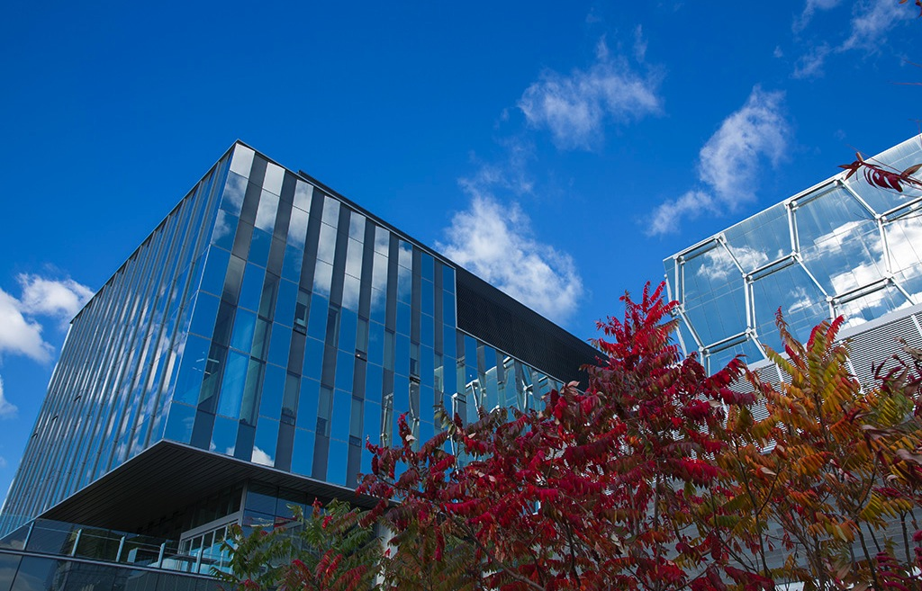

  WHAT IS WATERLOO?
  Canada’s most innovative university
  6 faculties, offering 100+ programs
  Very high entry standards
Notes:
Canada’s most innovative university
28000 undergraduates, 6000 graduate students
6 faculties, 100+ programs = diversity and specialization
Very high entry standards
Minimum 80%, many require 85-95% overall
Career-focused students
Self-contained campus within small student-friendly city known as Canada’s technology hub

Slide 3
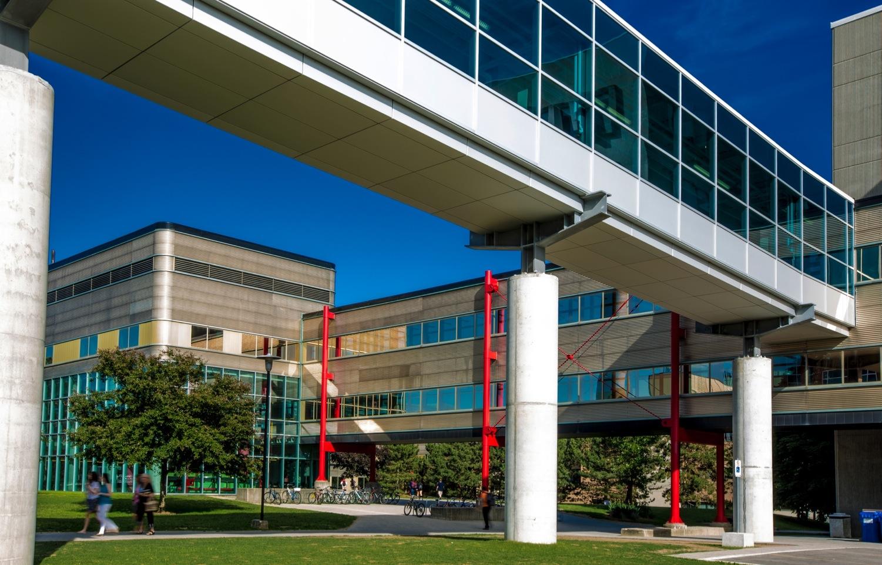
  WATERLOO’S STRENGTHS
  Academic excellence
  Research excellence
  Co-operative education
  Entrepreneurship
  Graduate success
Notes:
Follow this up with co-op video

Slide 4
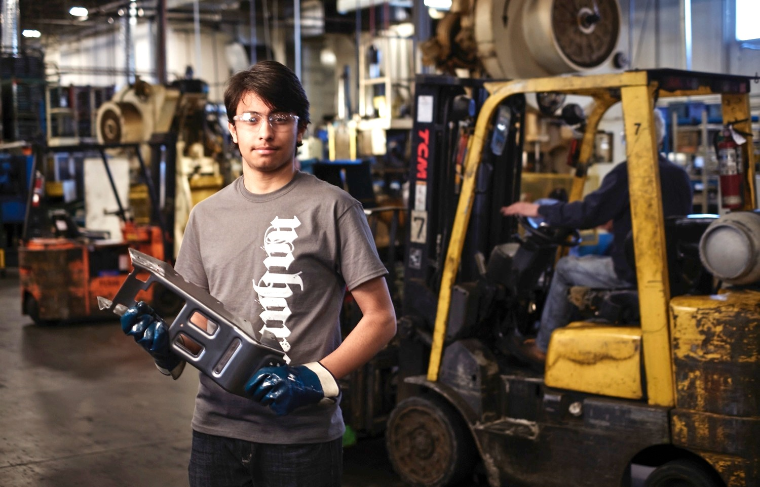
  CO-OP AT WATERLOO
Co-op experience leads to stronger career prospects and higher starting salaries upon graduation
Notes:
Co-op = alternate 4-month terms of study and 4-month paid work terms
Up to 2 years of paid work experience
Potential earnings of $37000 - $77000
Opportunity to try various jobs and test variety of careers while completing the degree
Establish a network of employment contacts to improve career success
Co-op experience leads to stronger career prospects and higher starting salaries upon graduation

Slide 5
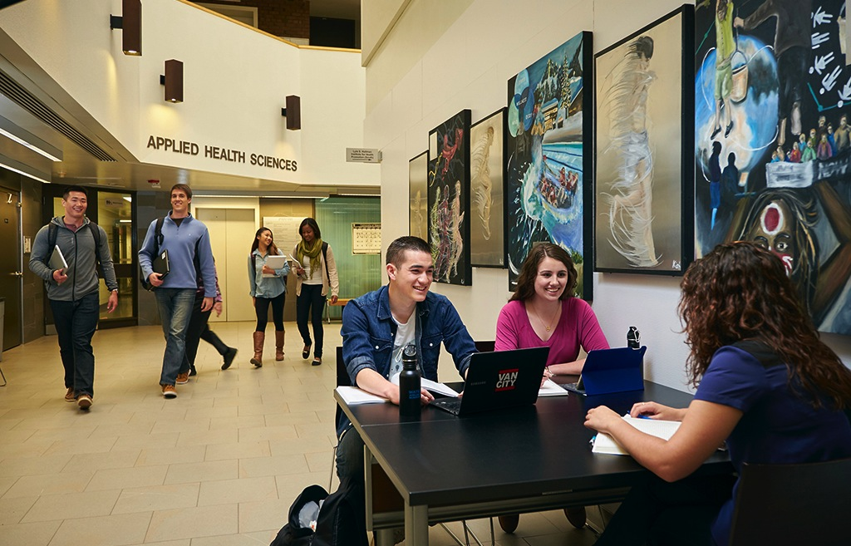
  APPLIED HEALTH SCIENCES
Assess, treat, and prevent illness and injury, and optimize quality of life
Good preparation for health professions
Notes:
Focus: assessment and treatment, preventing illness and injury, optimizing quality of life
Studying real-world problems in the classroom = graduates well-prepared for health professions or professional schools, such as medicine.
Key Programs:
Kinesiology: science of human movement, with a focus on four core areas: Biomechanics, Physiology, Neuroscience, and Social Sciences
Health Studies: Focus on the prevention of illness – proactive rather than reactive
Public Health: how to facilitate change in the social, political, environmental, and economic conditions that affect our health
Recreation & Leisure Studies: how health and well-being are enhanced through the effective use of leisure

Slide 6
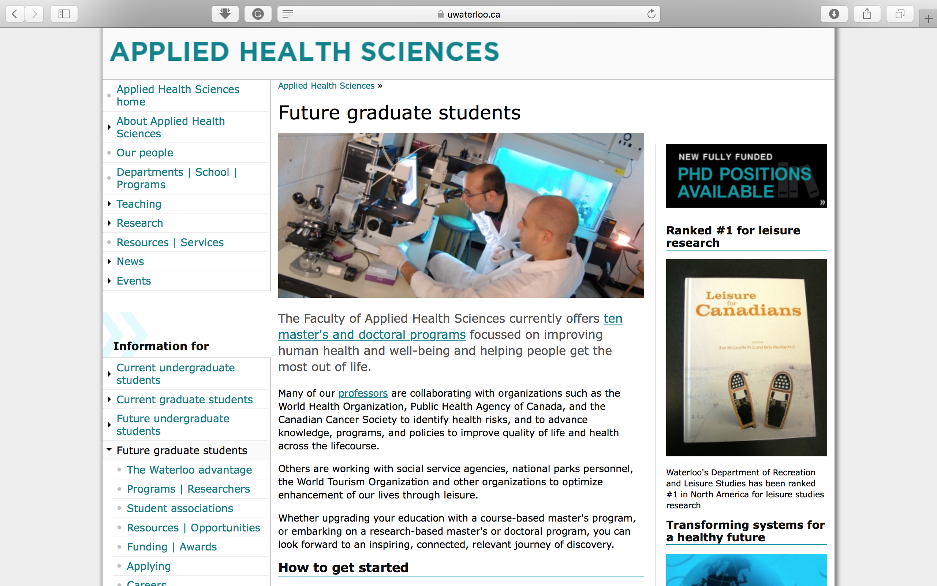

Slide 7

  ARTS
Maximum flexibility with 24 majors
Interdisciplinary approach, e.g., Global Business and Digital Arts
Notes:
Interdisciplinary approach to research
social and applied science connections
Maximum flexibility in course selection and potential majors
24 different Majors grouped into Social Sciences, Humanities, Fine & Performing Arts, Languages & Cultures
Key programs:
Arts and Business
Accounting and Financial Management
Social Development Studies
Honours Arts
Global Business Digital Arts (relationship between content, business and technology and its application in digital economies)

Slide 8
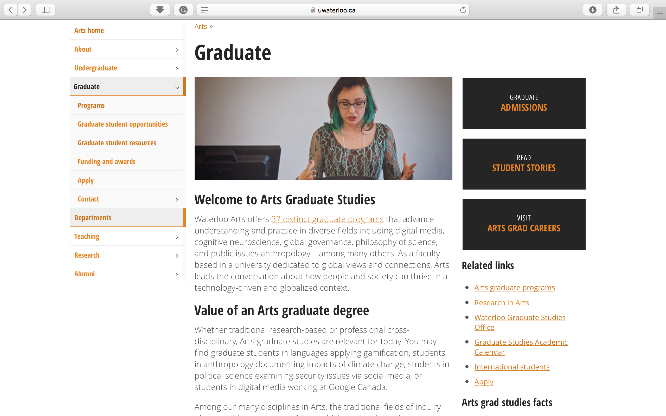

Slide 9
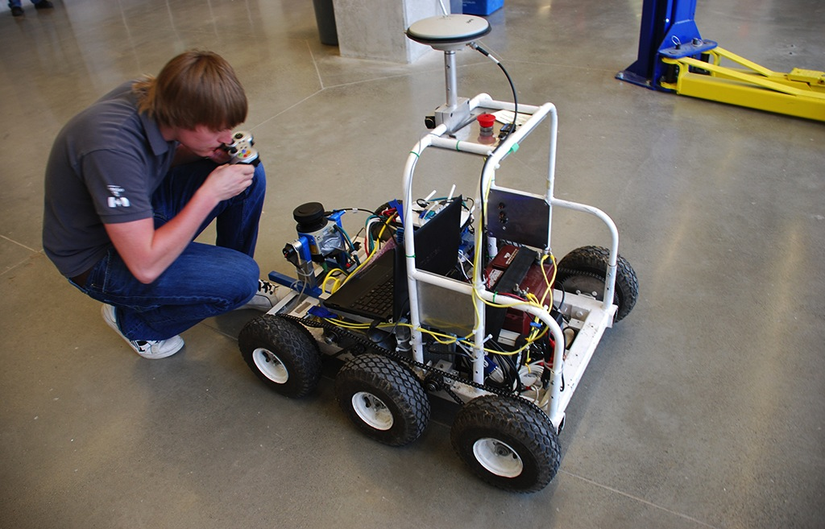
  ENGINEERING
100% co-op with exceptionally high entry standards
Origin of many start-up companies
Notes:
Largest in Canada, exceptionally high entry standards
Direct entry into specific branch (eg. Chemical) = supported smaller cohort + inventive design teams
100% co-op: immersive education = knowledge students learn in the classroom is strengthened with real-world experiences
Entrepreneurial focus: students innovate with novel ideas and incubate these ideas early in their careers
14 different branches of Engineering (includes Architecture)
Key programs:
Architecture
Mechanical Engineering
Civil Engineering
Chemical Engineering
Systems Design Engineering
Offers degrees in emerging multidisciplinary areas such as biomedical, mechatronics, nanotechnology, and environmental engineering
Strong reputation for leadership and innovation, with many start-up companies originating from Engineering students

Slide 10
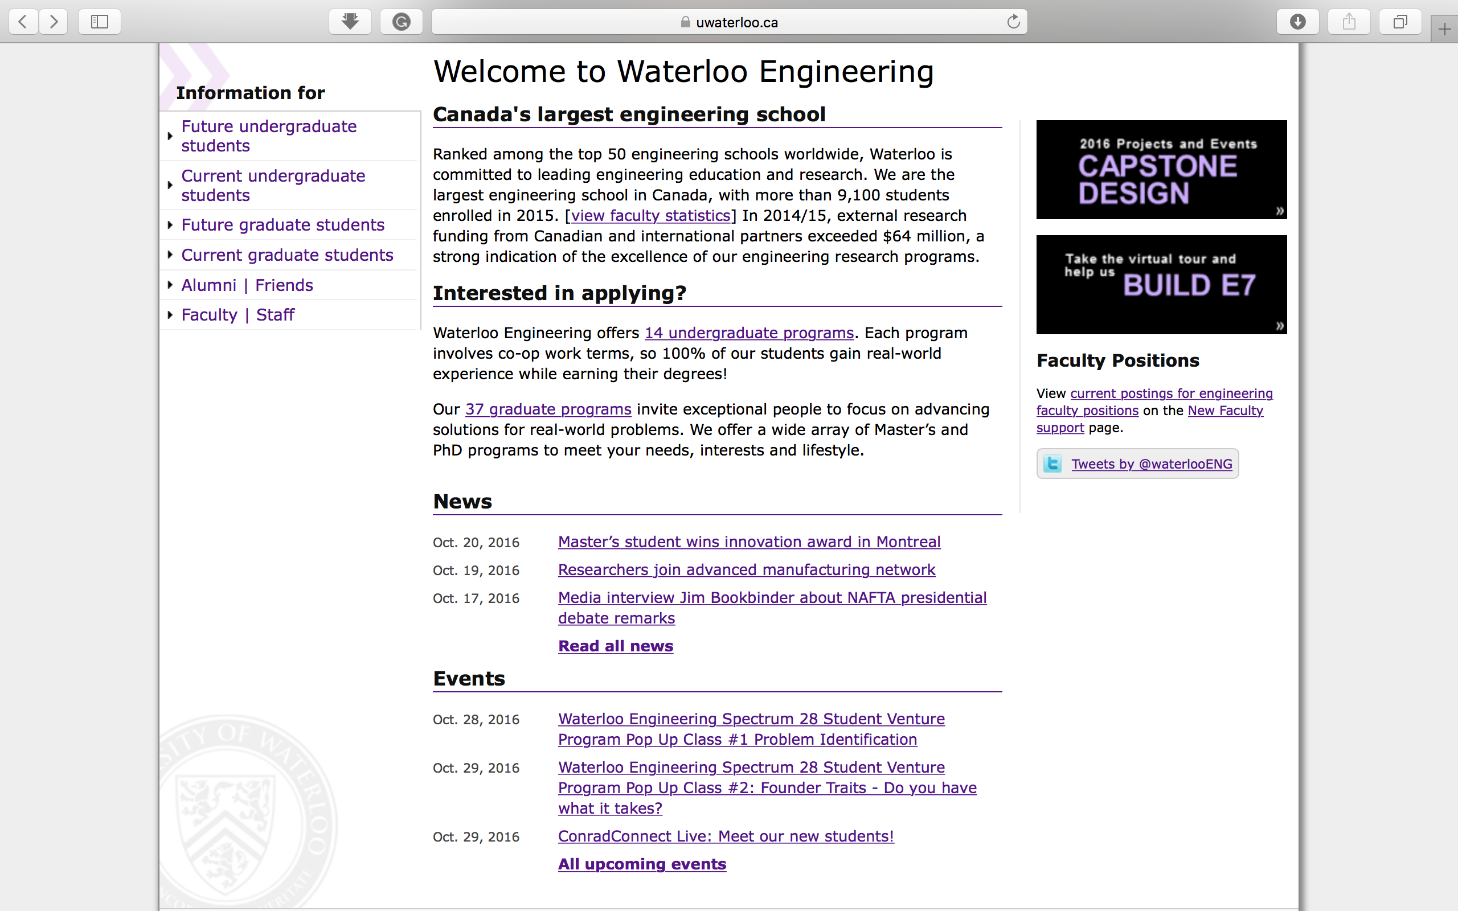

Slide 11

  ENVIRONMENT
Focus on sustainability of human and natural environments
Unique programs include Geography and Aviation, Knowledge Integration
Notes:
Creates knowledge, nurtures learning, and promotes action to achieve sustainable futures in Canada and internationally
Focus on sustainability of human and natural environments
Key programs:
Environment and Business
Environment and Resource Studies
Geography and Aviation
Geography and Environmental Management
Geomatics
International Development
Knowledge Integration
Planning

Slide 12
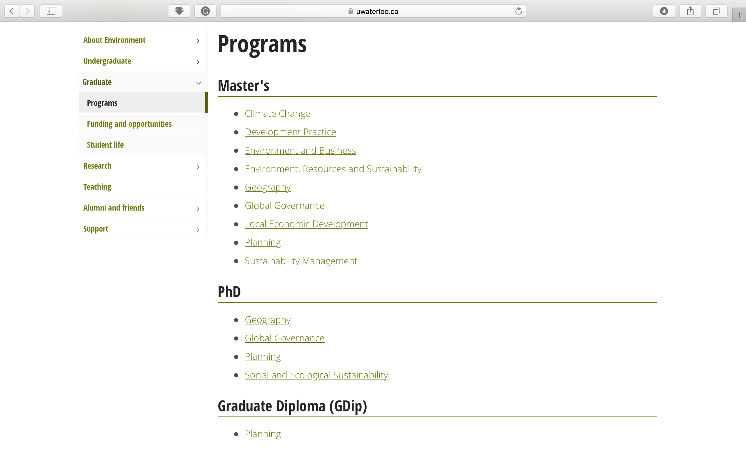

Slide 13

  MATHEMATICS
World’s largest concentration of math and computer science talent
Strengths in actuarial science, statistics, financial analysis, math and business, computer science
Notes:
Largest concentration of mathematical and computer science talent in the world; breadth of choices; exceptionally high entry standards
Three entry points: Computer Science, Business and Accounting, and Mathematics
21 different program majors
Key programs:
Computer Science
Statistics and Actuarial Science
Mathematics, Business and Accounting
Pure mathematics
Combinatorics and Optimization
Advanced problem-solving skills applied to all areas of economy
Strengths in actuarial science, statistics, financial analysis, math & business, computer science

Slide 14
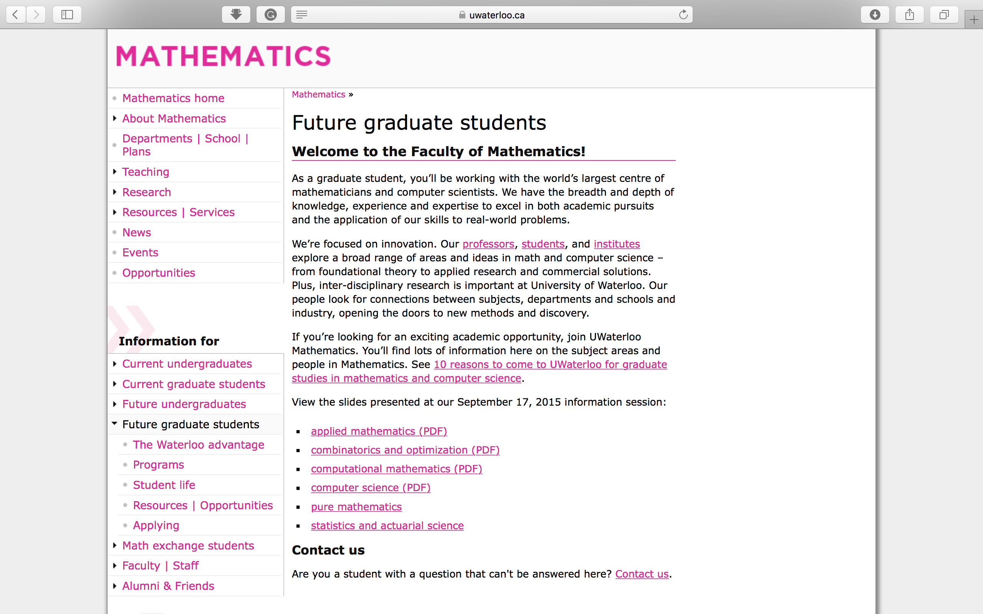

Slide 15
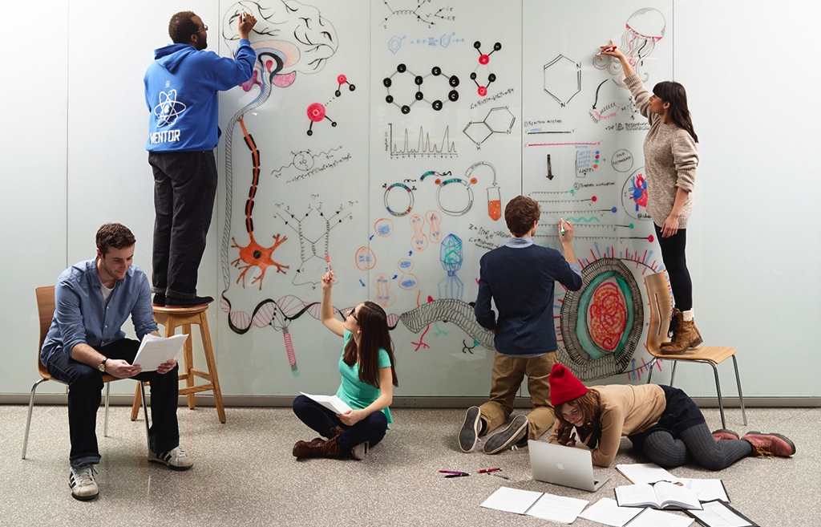
  SCIENCE
Broad offerings across life and physical sciences, plus innovative interdisciplinary programs
Notes:
Research focused studies with plenty of lab experience
18 different entry programs = ultimate degree customization, all leading to BSc
Key programs:
Biology
Chemistry
Earth and Environmental Sciences
Biotechnology/Economics and Biotechnology/Chartered Accountancy
Physics and Astronomy
Innovative programs combining science & business studies, science & aviation
Broad offerings across life and physical sciences

Slide 16
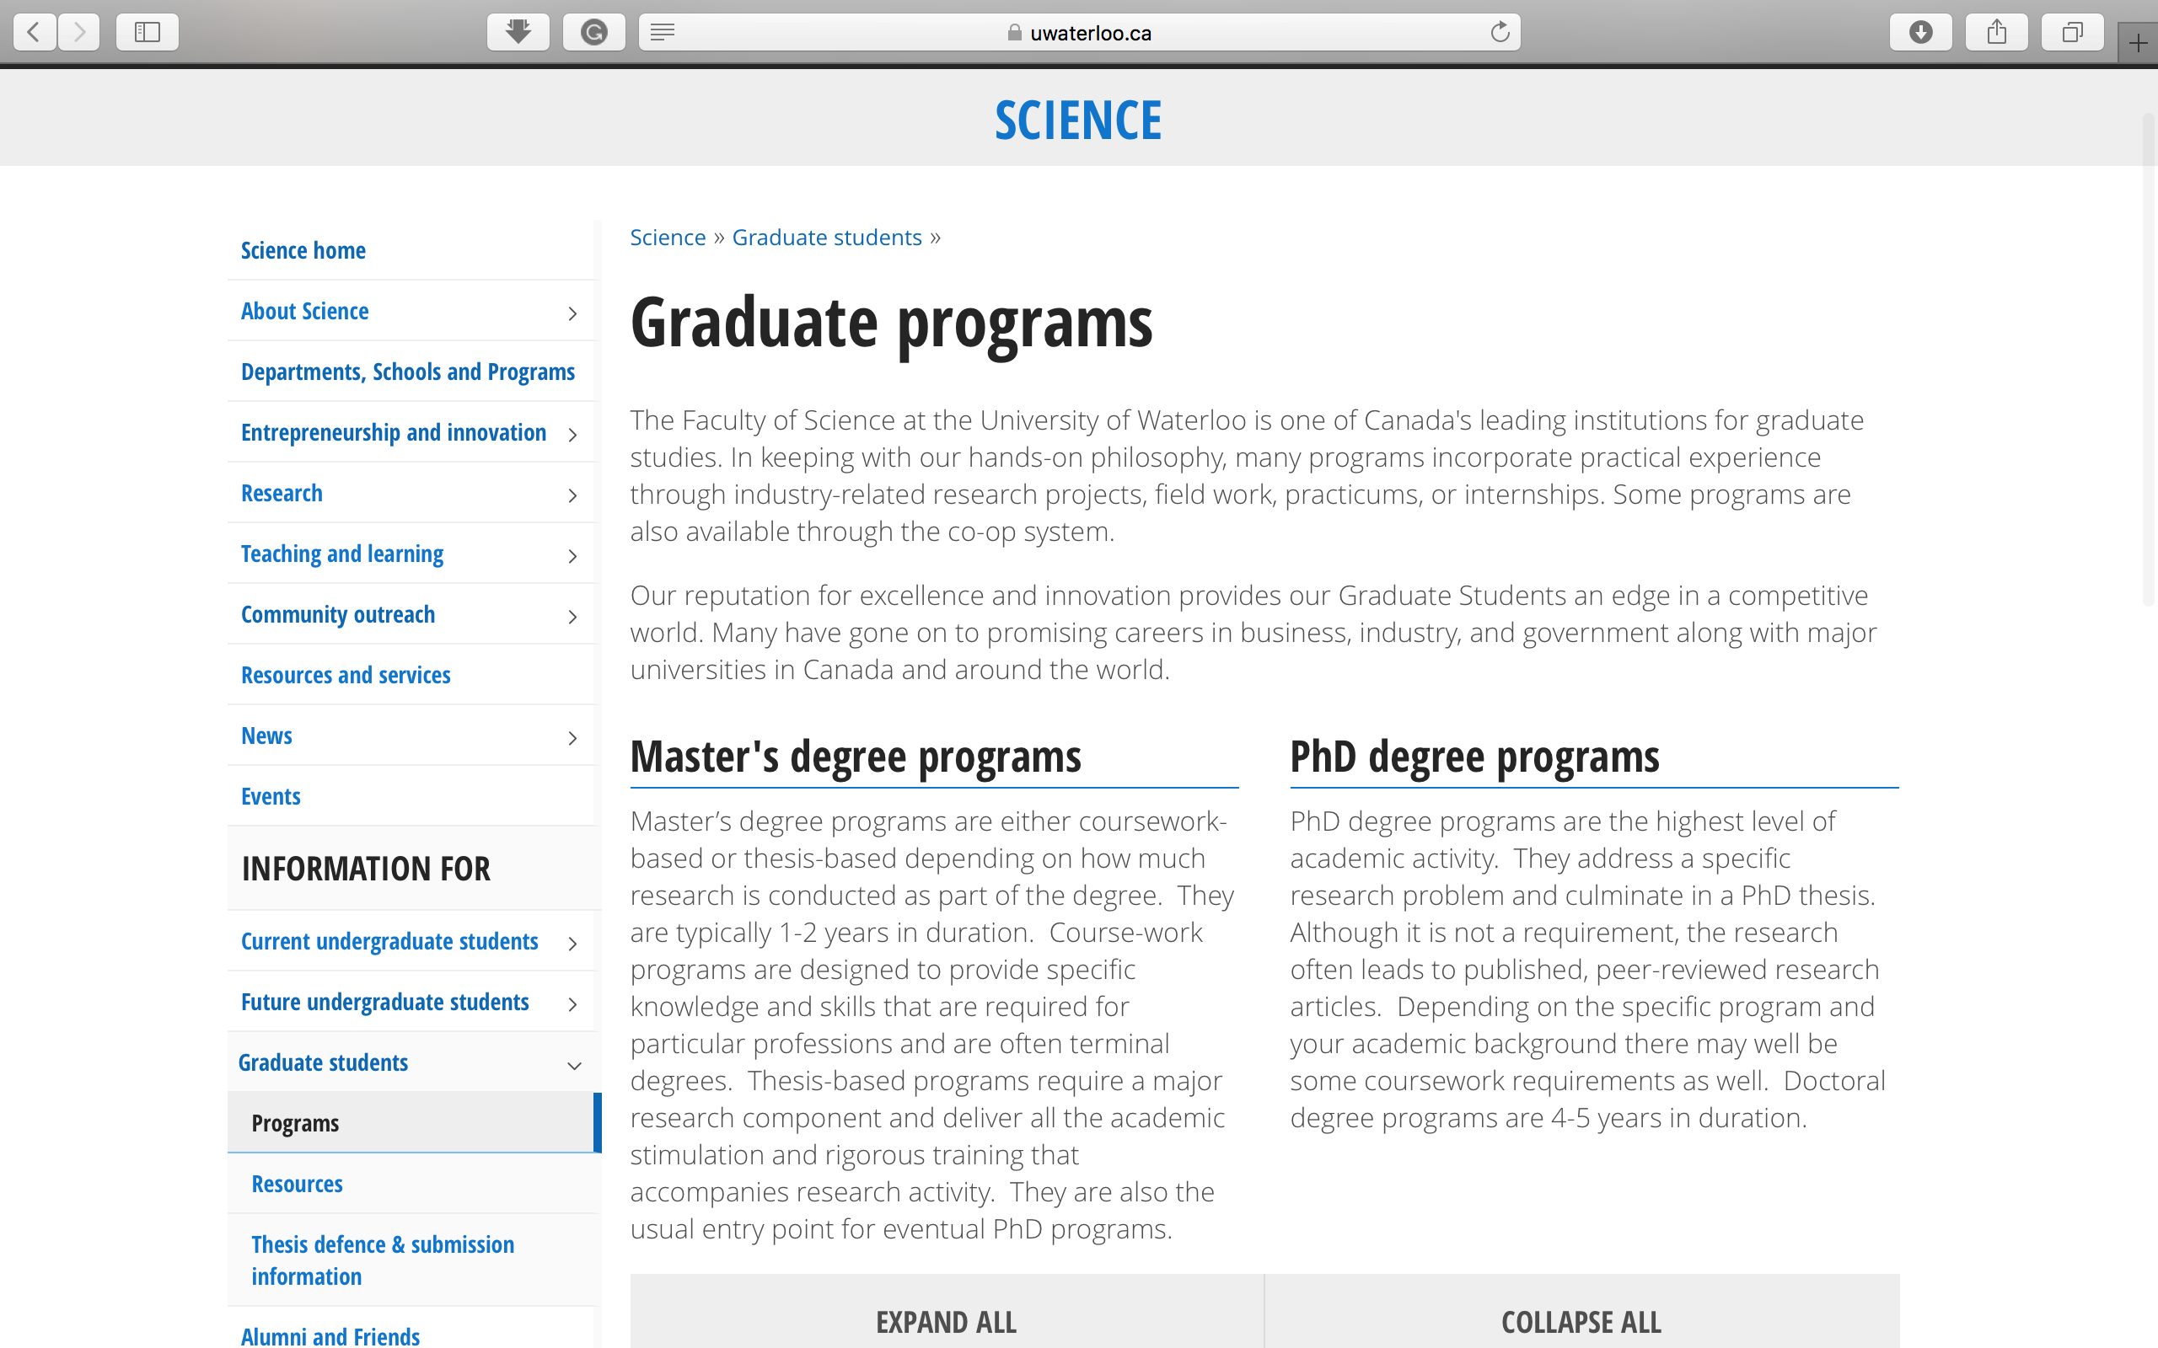

Slide 17
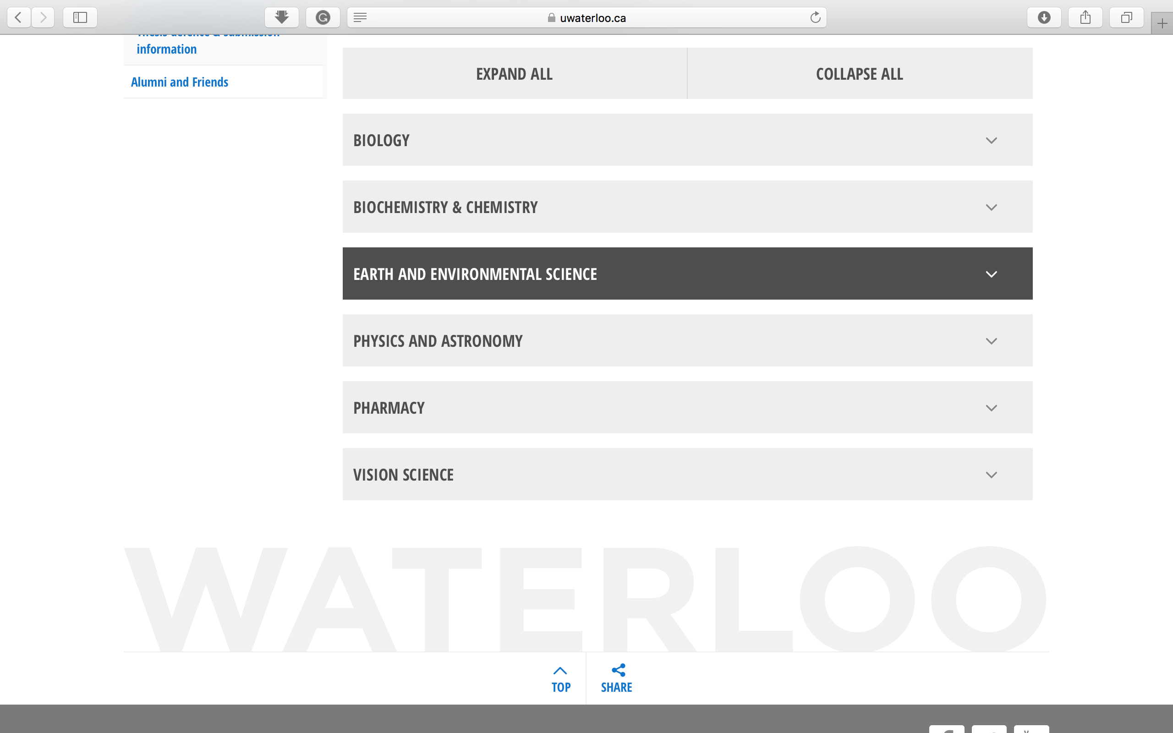

Slide 18
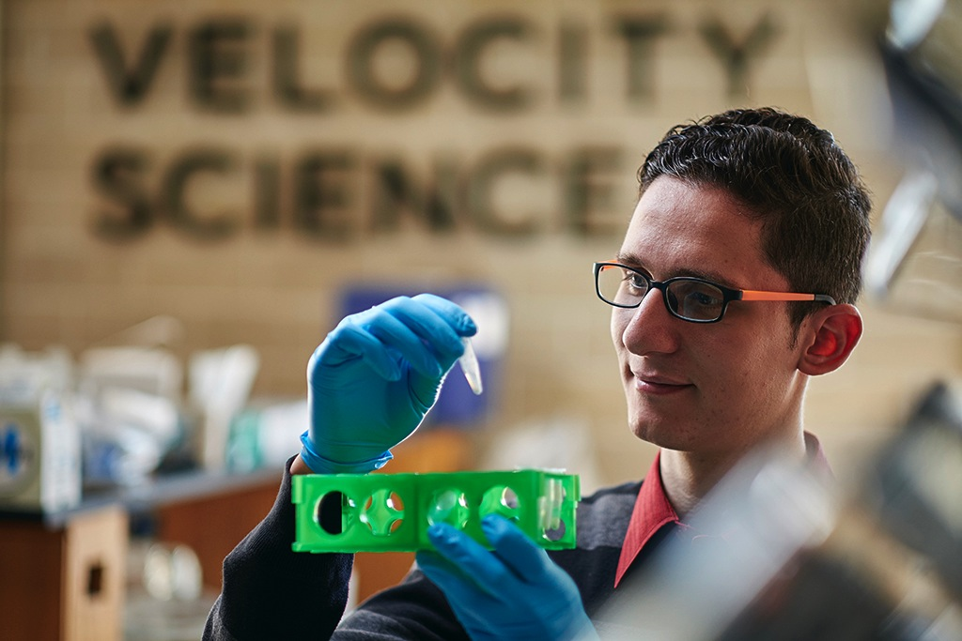
  ENTREPRENEURSHIP AT WATERLOO
Student + idea + Waterloo = innovation
Velocity Residence, Velocity Science, Greenhouse provide mentors and education
Notes:
Innovation: acting on an idea using Waterloo’s extensive support infrastructure
student + idea + Waterloo = innovation
Velocity
Residence
Velocity Science
Greenhouse (social entrepreneurship)
UW Entrepreneurship Society
Faculty mentors, industry role models
Courses, seminars, design projects, hackathons
Ideas Start Here video

Slide 19
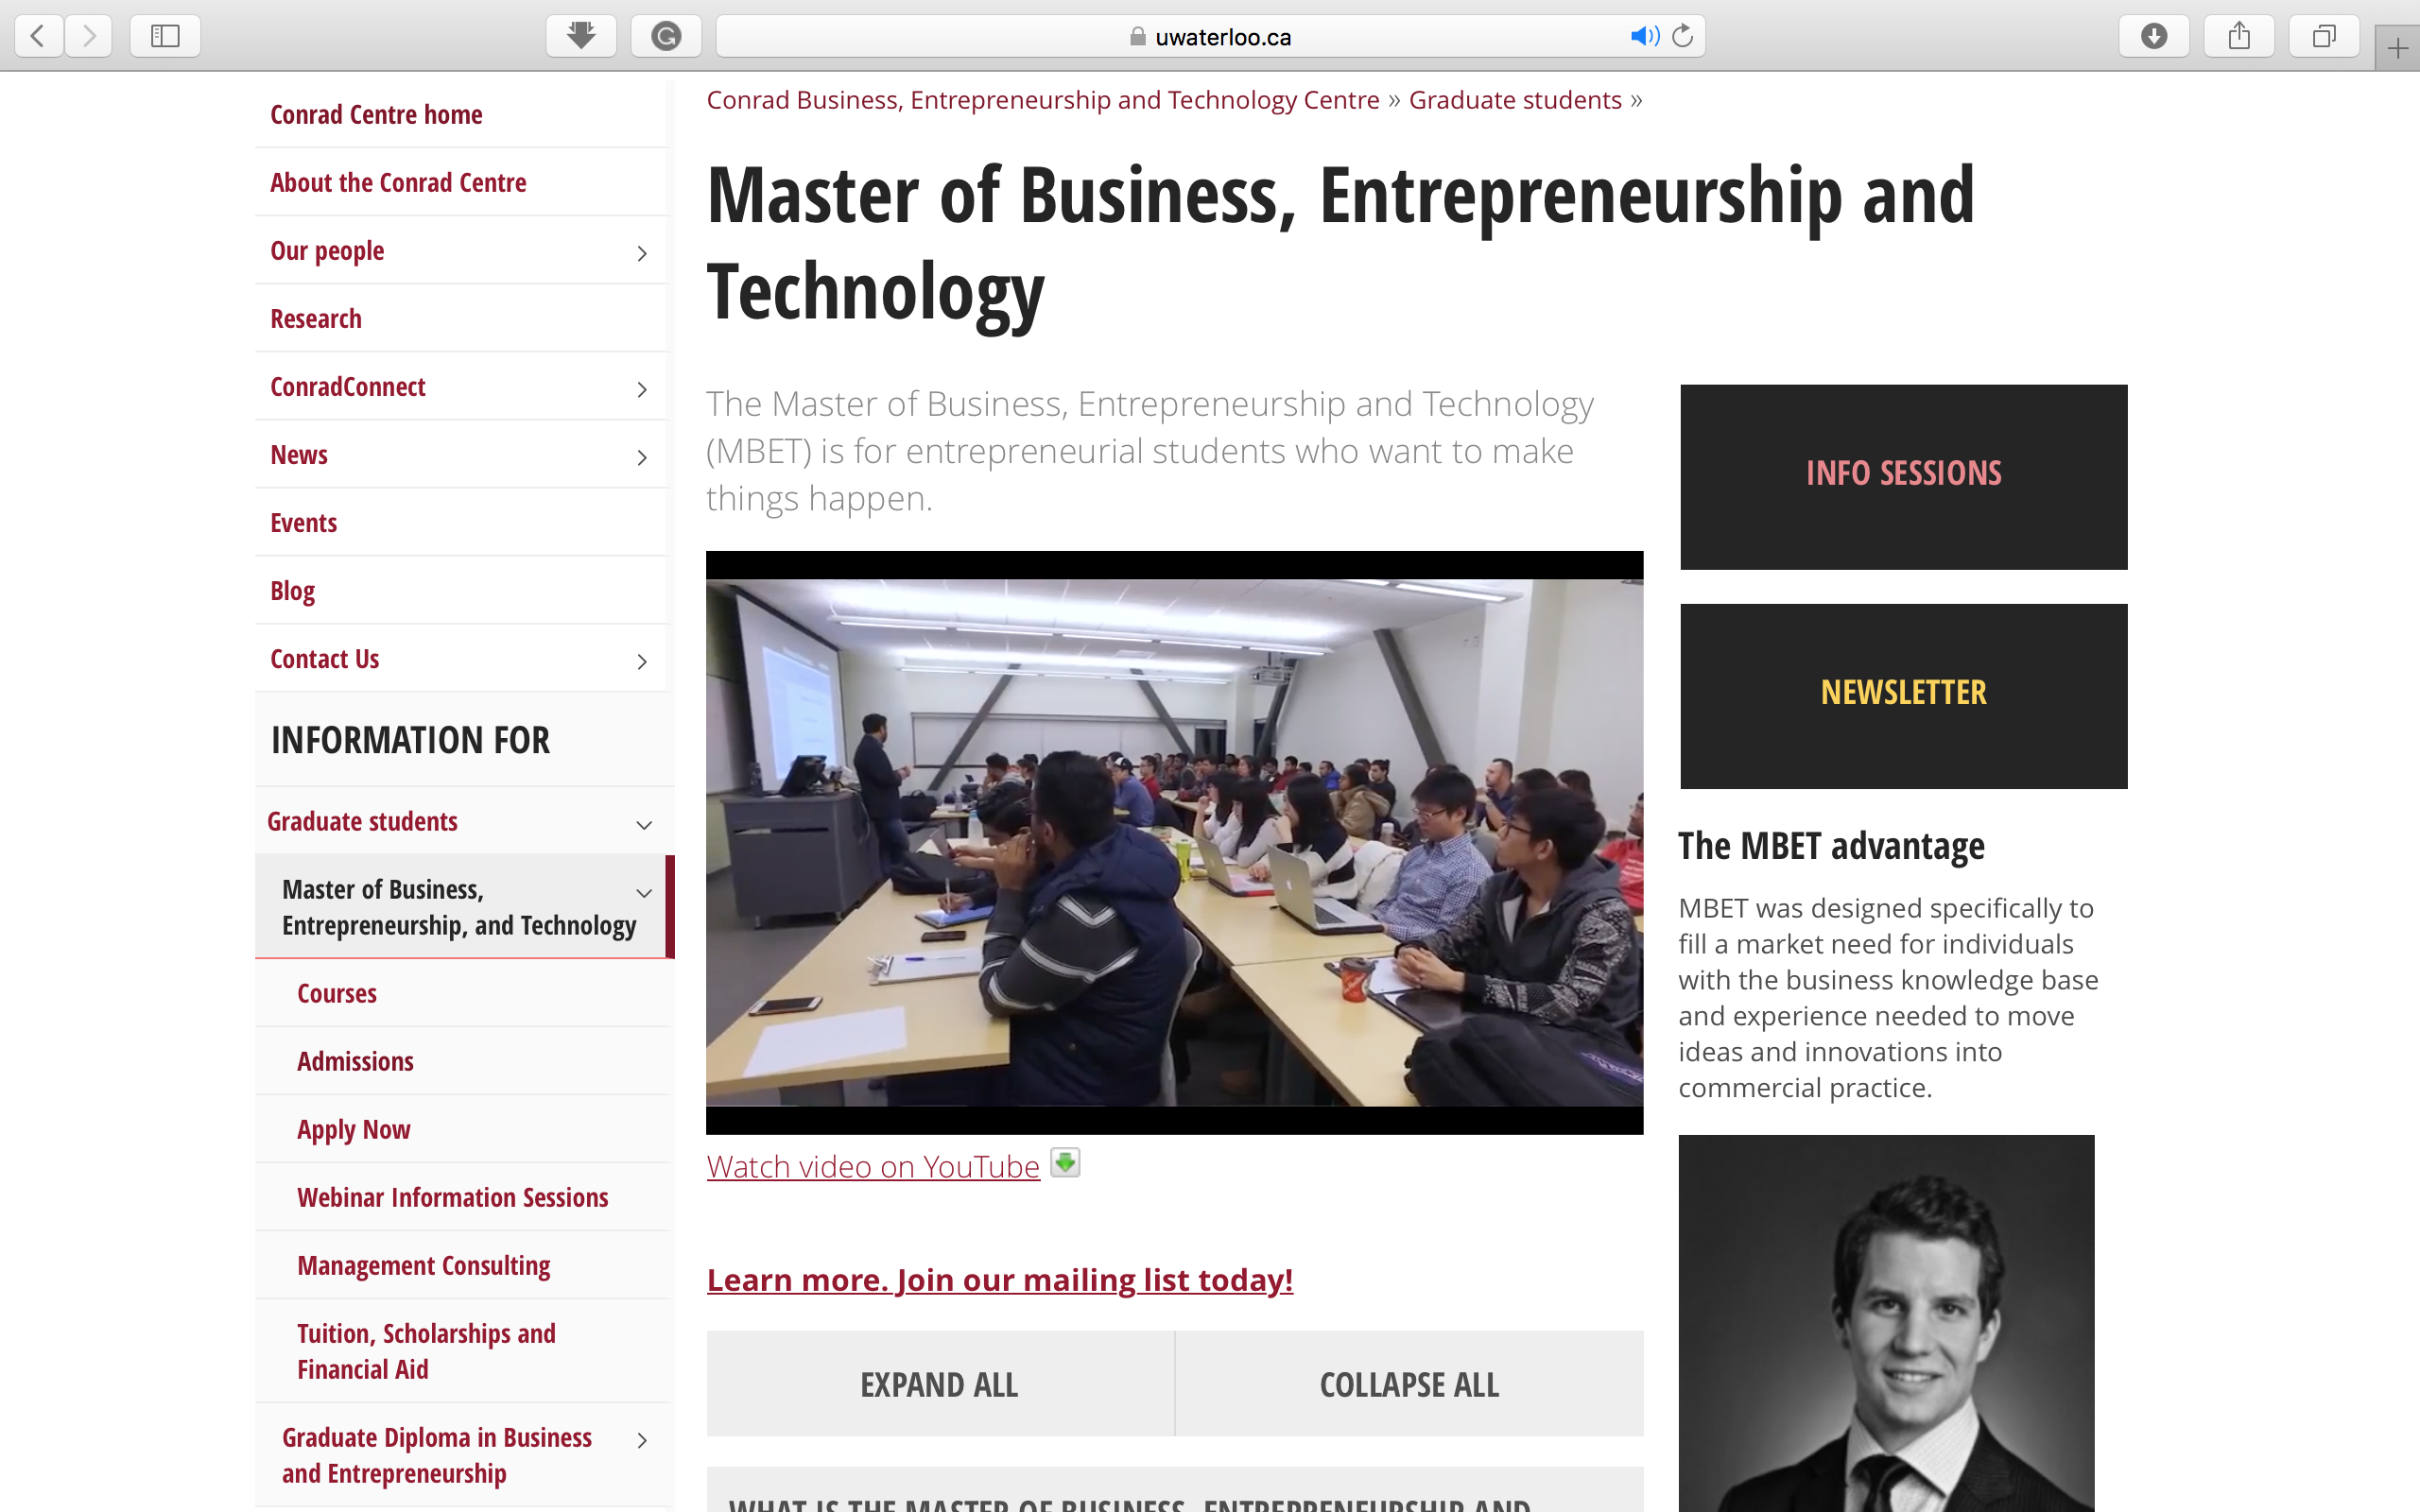

Slide 20

  THE TYPICAL WATERLOO STUDENT?
  Hard-working • Independent • Smart
  Focused on my future career • Problem solver • Motivated • Don’t give up easily
Notes:
Waterloo students entering their first year of study describe themselves as:
Hardworking
Independent
Smart
Focused on my future career
Problem Solver
Motivated
Don’t give up easily
*refer to series of “why I chose…” videos on www.findoutmore.uwaterloo.ca

Slide 21
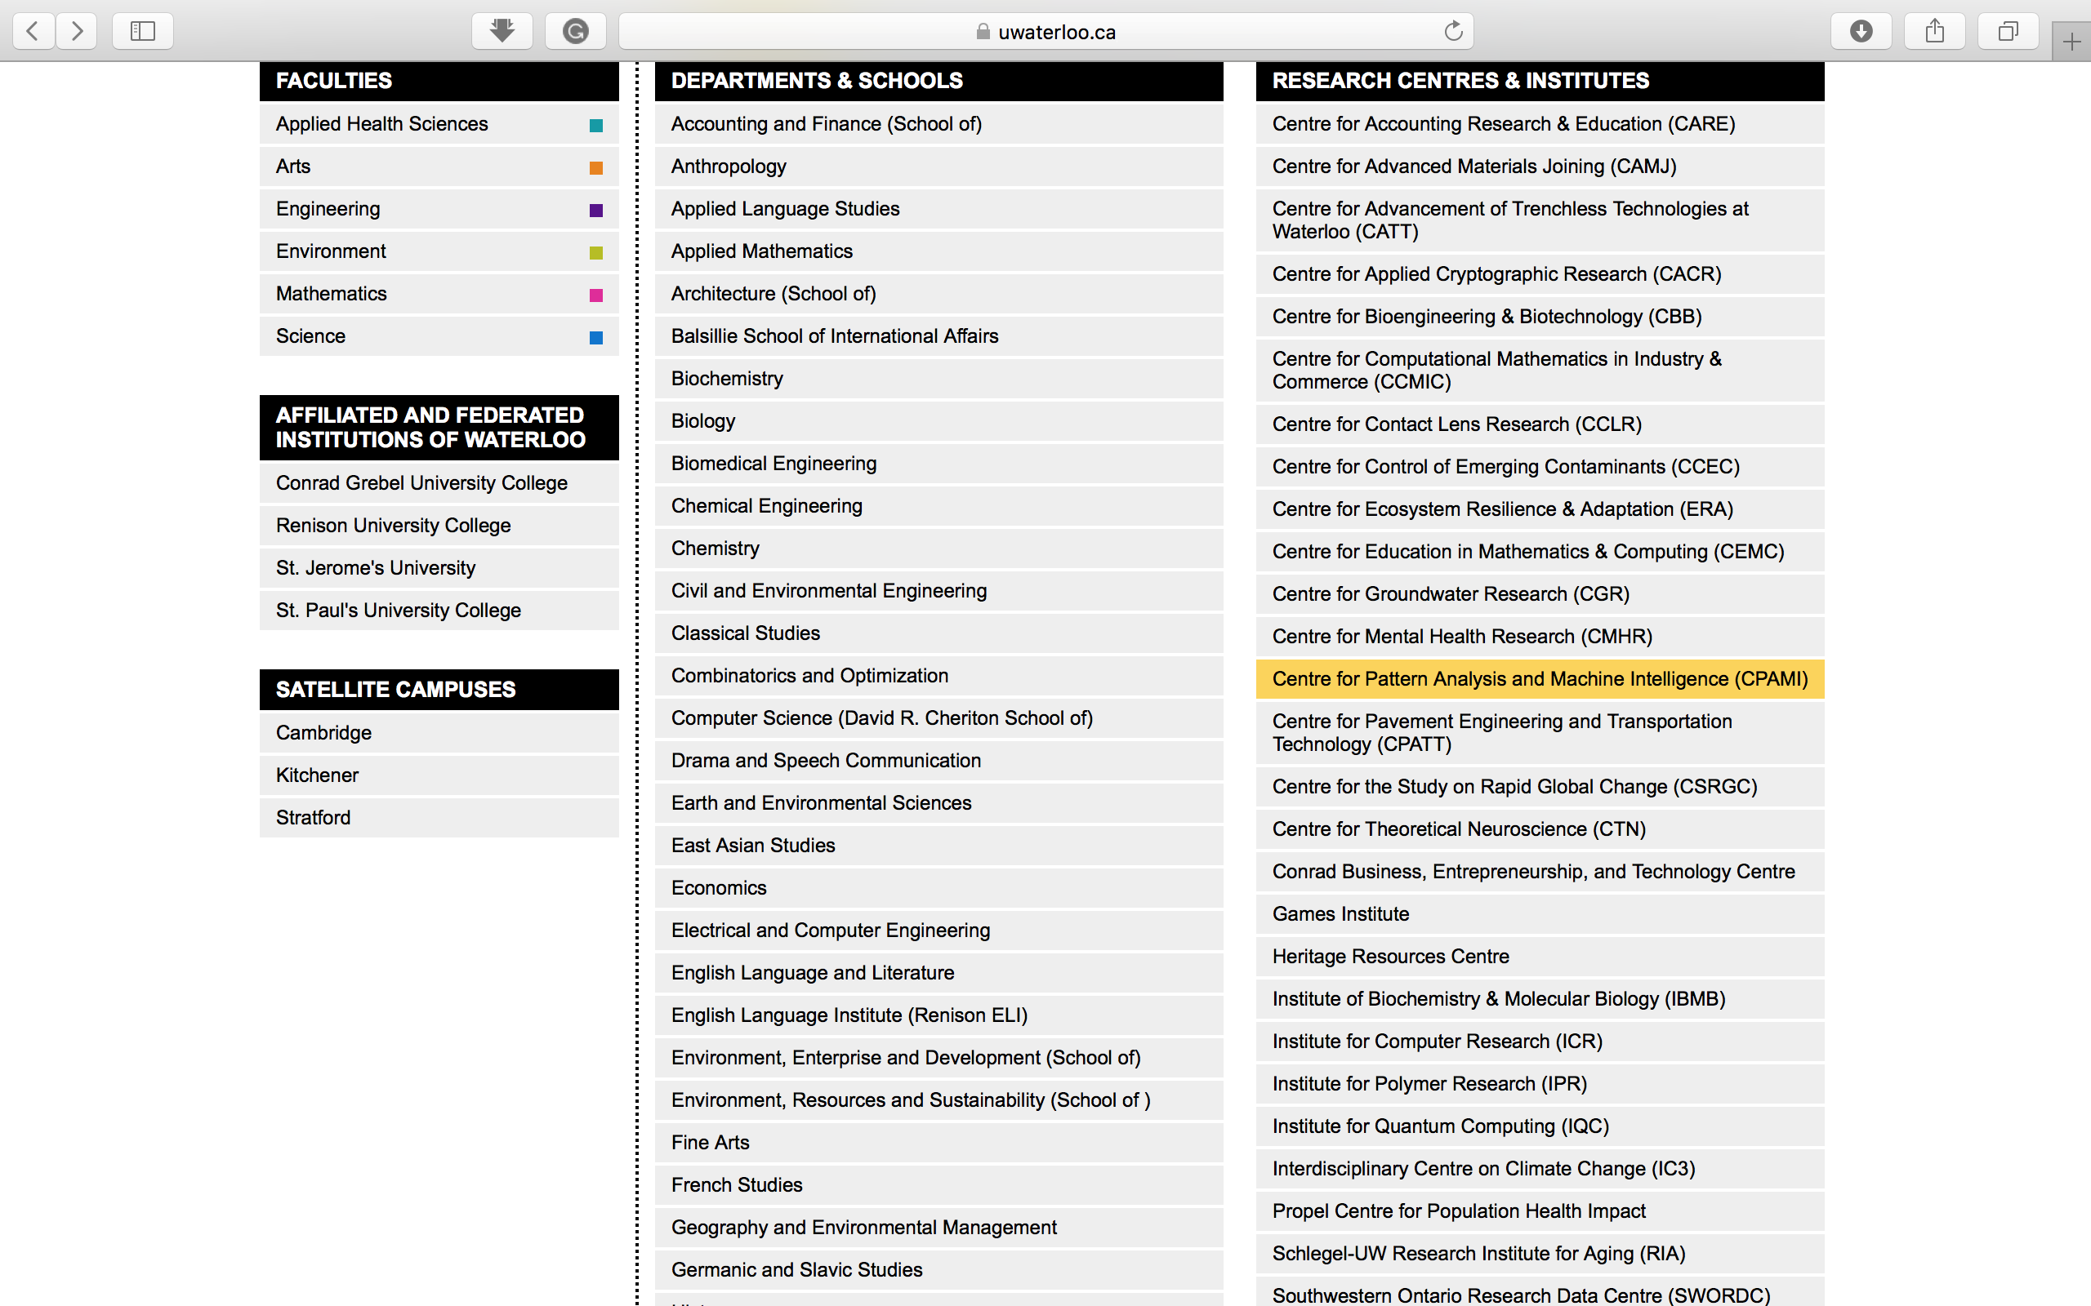
Interdisciplinary

Slide 22

  STUDENT LIFE
A diverse, student-centered community
100+ culturally based, socially focused, personal interest groups
Notes:
On-campus residence guarantee in first year
9 different residence options; variety of styles
Includes meal plan (vegetarian, halal, vegan options)
Student services
Student Success Office, Health Services, academic advisors, tutors in residence, Centre for Career Action, Counselling Services, Federation of Students
Student clubs
Over 100 different culturally based, socially focused, personal interest groups
Athletic facilities
Fitness studios, intramural sports leagues, competitive teams, instructional courses
Waterloo = diverse, student-centered community
Wide variety of eateries, coffee shops, shopping choices, entertainment options, cultural & social events
safety & security
Waterloo, It’s My Home video

Slide 23
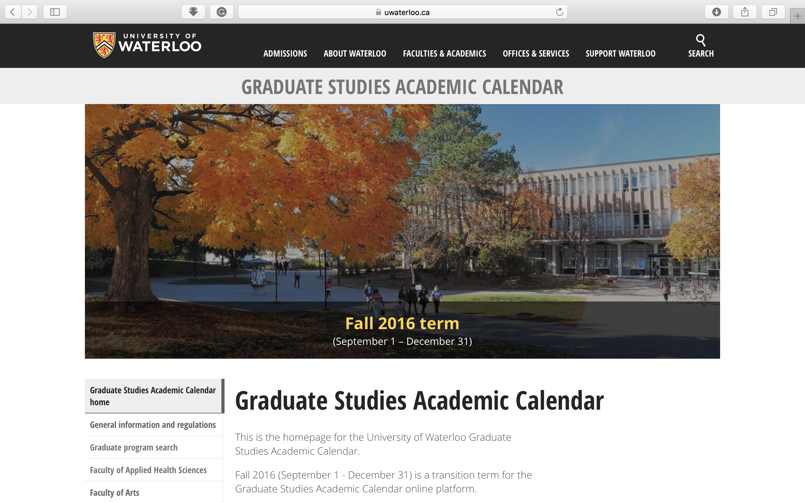

Slide 24
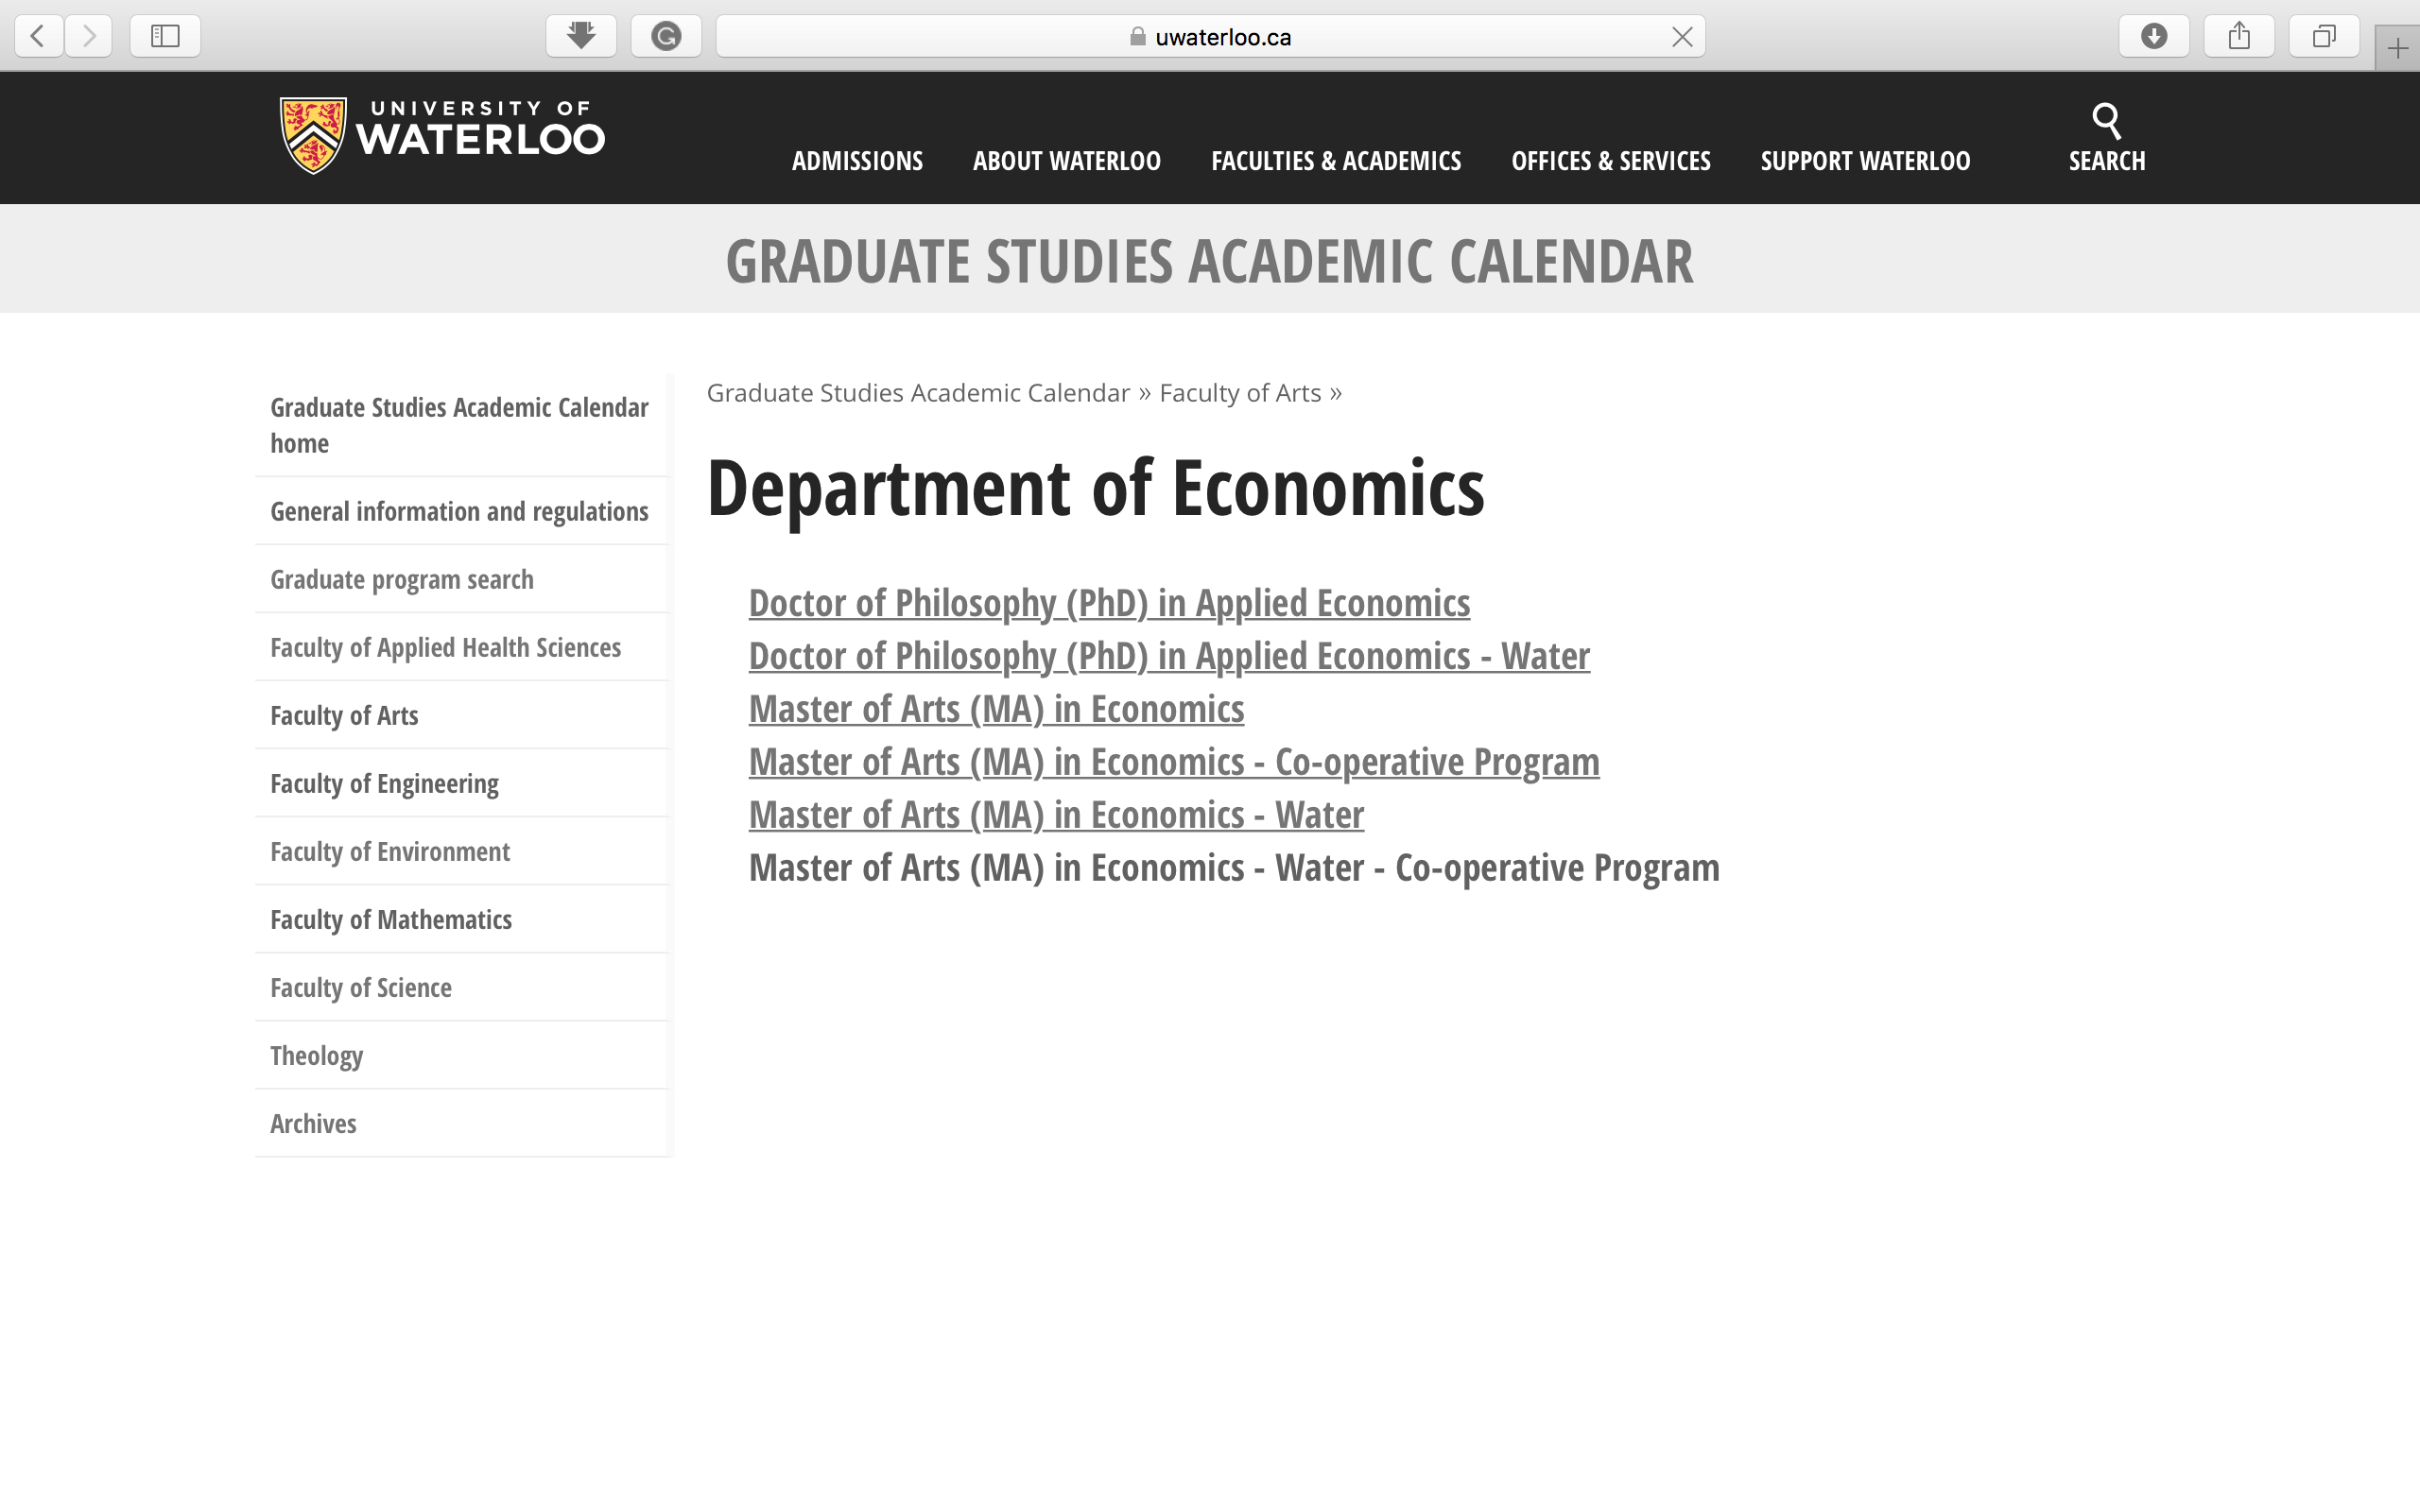

Slide 25
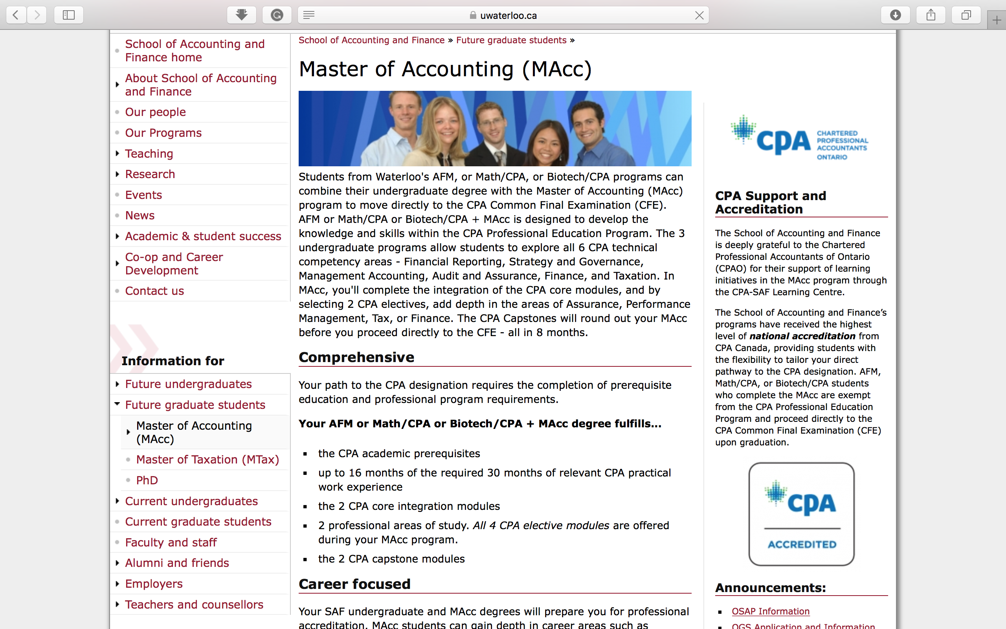

Slide 26
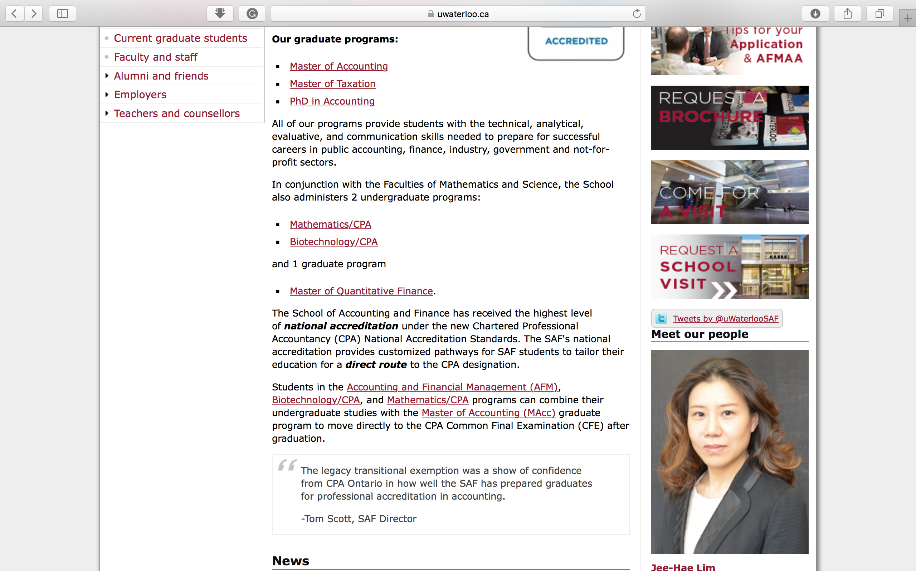

Slide 27
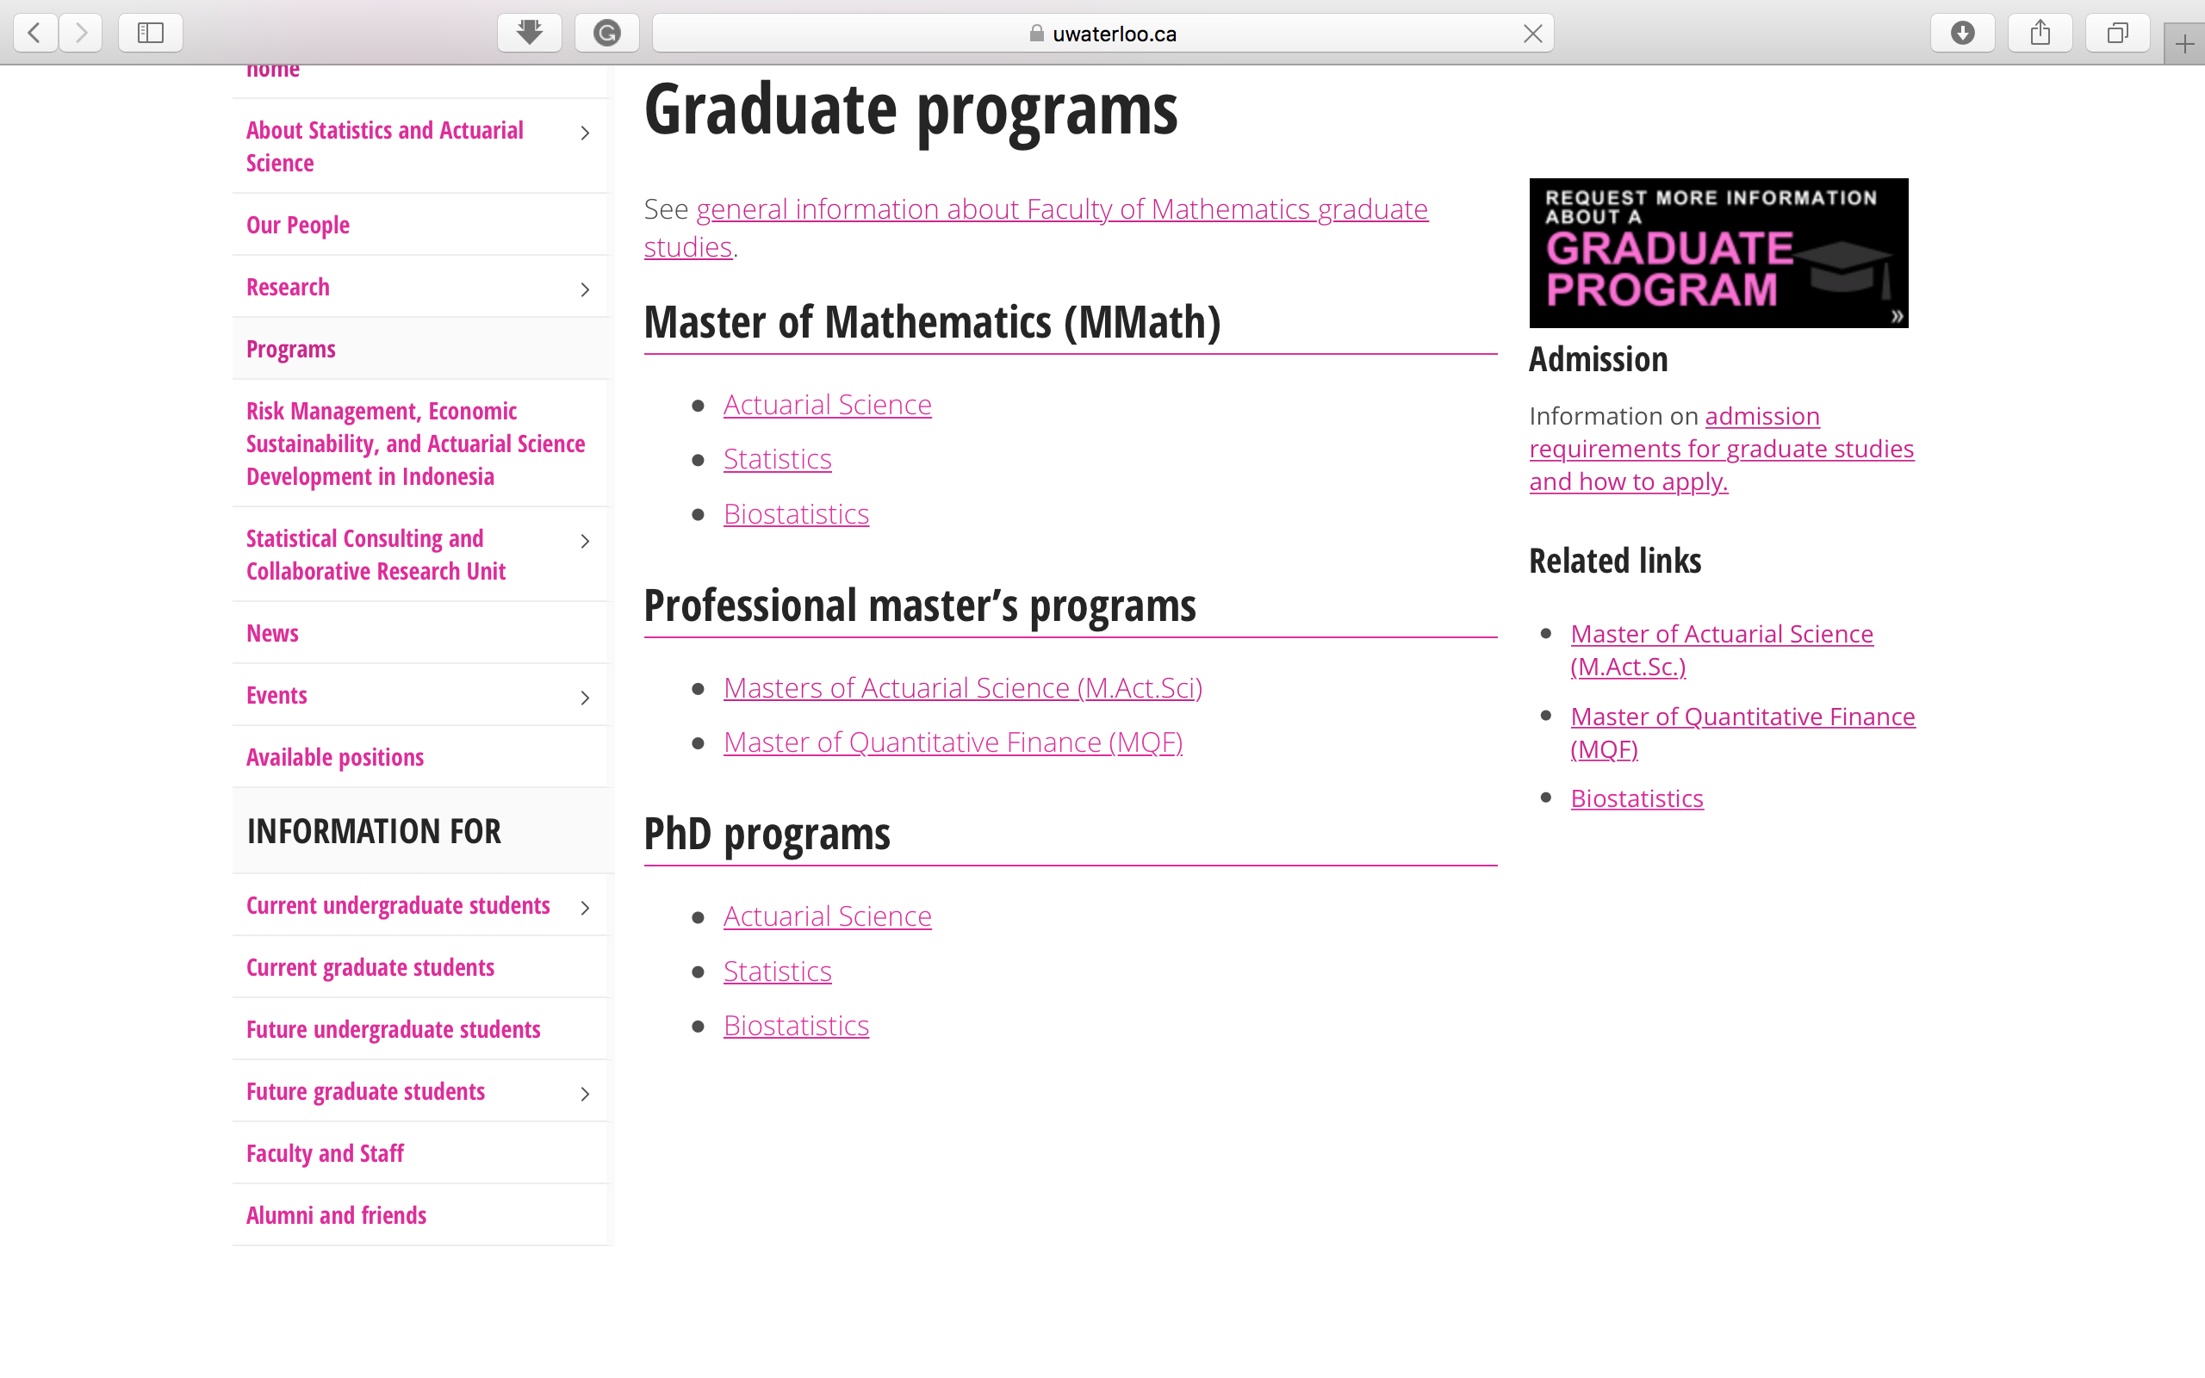

Slide 28
CONTACT INFORMATION
YUAN XI 袁希
YUAN.XI@UWATERLOO.CA
Program Director, China
Waterloo International,
University of Waterloo
+86 188 101 33383
WeChat: superfy-yuanxi

