Slide 1
Jackee Ma,
Operations Director
Warwick Beijing office

Slide 2
 | About Warwick
 | Faculties & Courses
 | Entry Requirement
 | Life as a Warwick Student
The
topics
we will
cover today

Slide 3
QUIZ TIME!

Slide 4
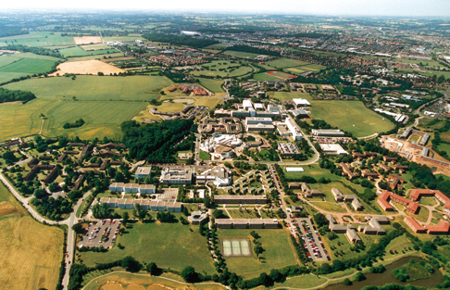
Which year was the University of Warwick established?
1925
1945
1965
1985

Slide 5
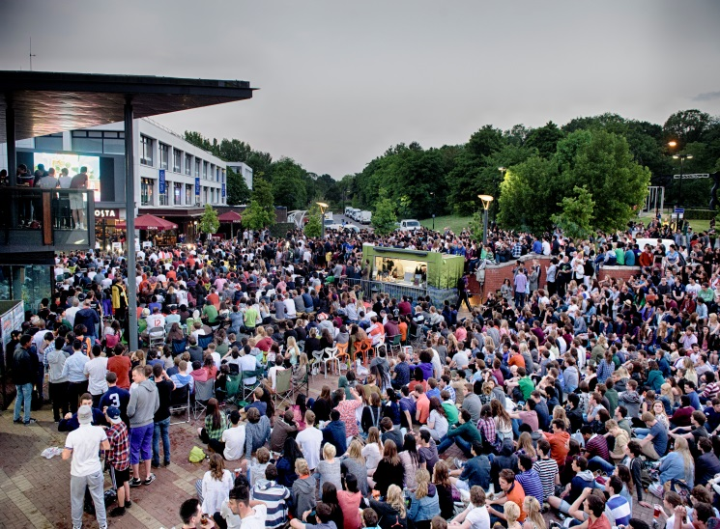
How many students are there at Warwick? A. 20,000 B. 24,000 C. 28,000 D. 30,000

Slide 6
How many International Students at Warwick?
6000
7000
8000
9000

Slide 7
Why Warwick is the right choice
Warwick is one of only three Universities to remain consistently in the top 10 UK rankings for the past ten years.
Over
300 leading employers visit campus each
year
6th Guardian & Times League Tables 2016
3rd
QS ‘Top 50 under 50’
93%
Graduates undertaking further study or work
7th
Research Excellence Framework
15th Employer reputation
87%
World leading or internationally excellent research
78%
Of graduates
in professional or managerial
positions
48th
QS world ranking

Slide 8
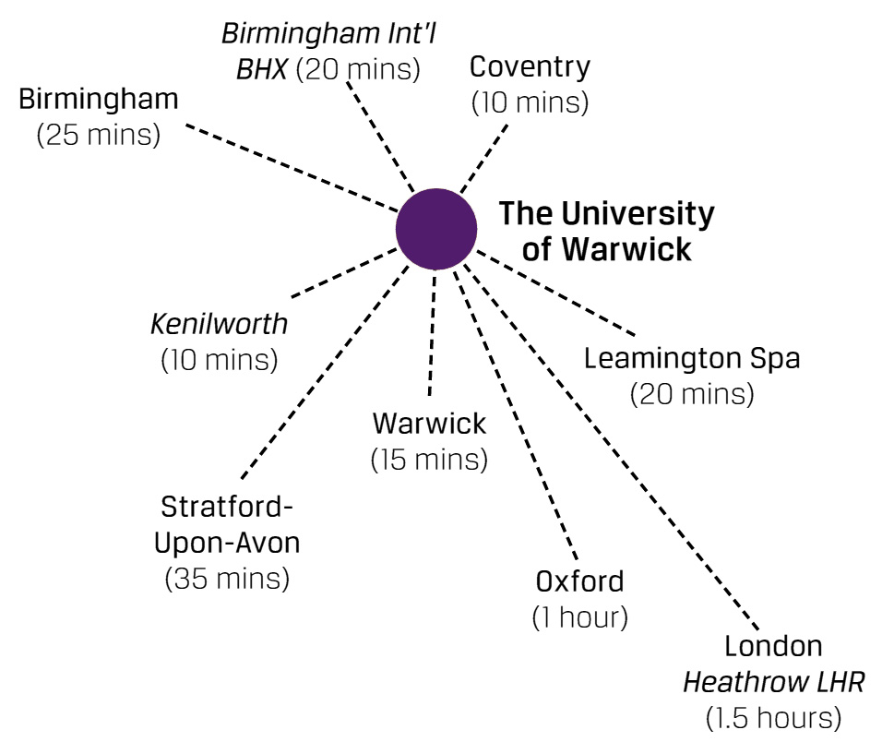
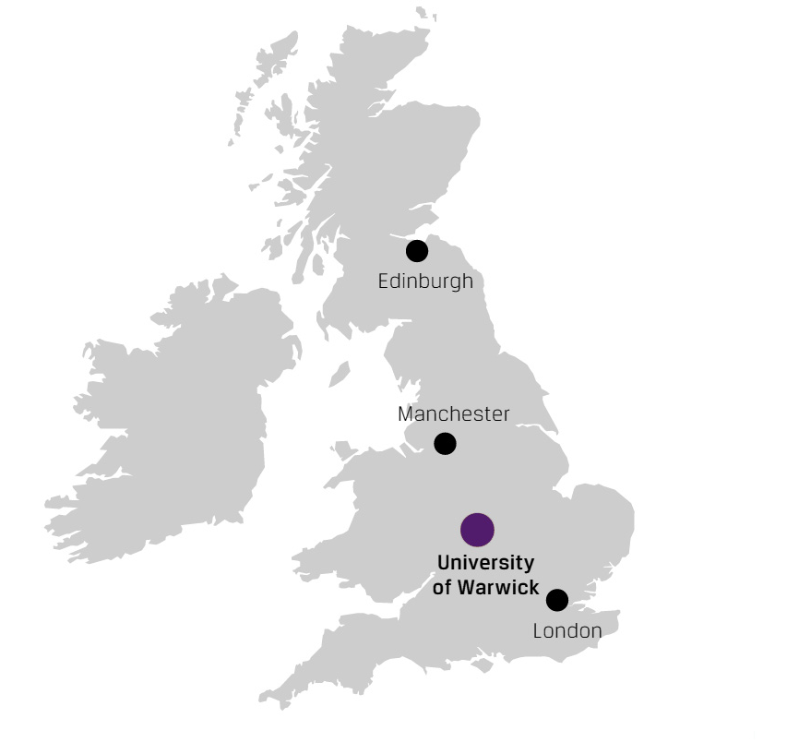
Location
Central London (1 hour)
Notes:
"Warwick has an excellent location. It's right in the heart of England, making it easy to reach by road, rail or air.“
Modern, urban life in the cosmopolitan cities of Birmingham and Coventry:
- Birmingham 20 minutes by train
Birmingham Int. Airport 10 mins by train
London Euston 1 hour by Virgin train
Historic centres of English culture such as Stratford-upon-Avon with its Shakespeare connections, and the 18th-century town of Leamington Spa, now a vibrant student town with great bars, restaurants and clubs
The traditional English rural landscape of the Cotswolds

Slide 9
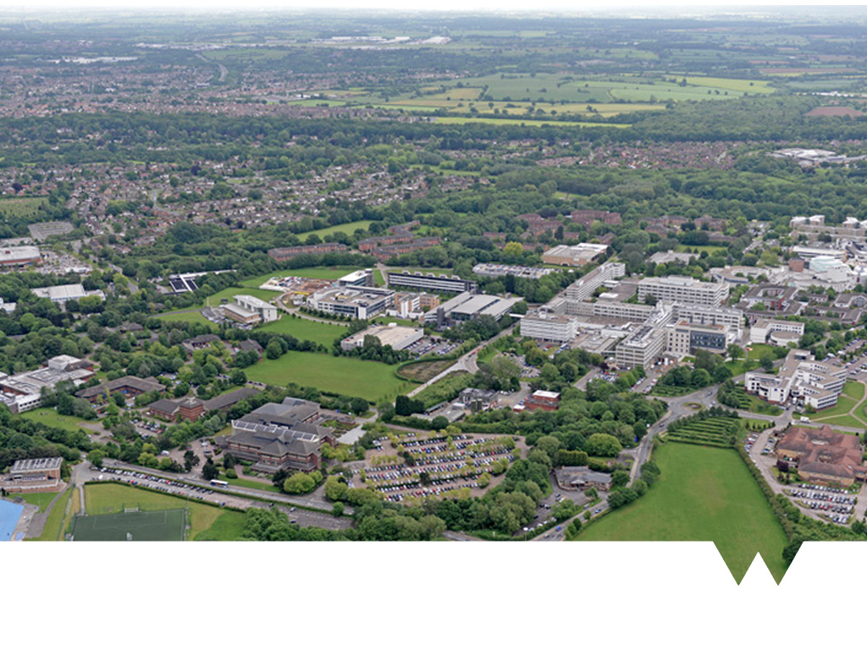
Why Warwick is the right choice
Campus
Notes:
Talk about central campus, pointing out library, arts centre, accommodation blocks round the outskirts and the city of Coventry off to the left

Slide 10
Faculties
Arts / Humanities
Social Sciences
Science and Engineering
Medicine (PG only)
Notes:
After months of consulting, planning and preparation, you'll start to see the wider implementation of our new brand

Slide 11
Arts / Humanities
Classics and Ancient History
Comparative American Studies
English and Comparative Literature Studies
Film and TV studies
French Studies/ German Studies/ Italian
Hispanic Studies
Theatre Studies
History / History of Art

Slide 12
Social Sciences
Applied Linguistics
Economics
Education
Law
Philosophy
Politics and International Studies
Sociology
Warwick Business School

Slide 13
Warwick Business School
MSc Finance stream: Accounting & Finance, Finance, Finance & Economics, Financial Mathematics
MSc Business: Finance & Accounting, Leadership, Marketing
MSc Business Analytics
MSc Human Resource Management & Employment Relations
MSc International Business
MSc Information Systems Management & Innovation
MSc Management
MSc Marketing & Strategy

Slide 14
Science & Engineering
Engineering: Civil, Mechanical, Manufacturing, Electronic, Systems
Warwick Manufacturing Group(WMG): E-business, PPM, Logistics Management, International Trade...
Chemistry
Computer Science
Life Sciences
Mathematics and Statistics
Physics
Psychology
Notes:
After months of consulting, planning and preparation, you'll start to see the wider implementation of our new brand

Slide 15
PG Study
Notes:
Think about when you need to come to the UK and ensure you give yourself plenty of time to apply for your visa, book affordable flights etc

Slide 16
PG Entry Requirement
Minimum of a second class honours degree (or equivalent)
English Requirement: IELTS: 6.5-7.5
NO Pre-sessional English course for WBS
Students are suggested to confirm with department if they’d like to apply for Pre-sessional course
Do NOT apply with an @sogou.com, @163.com or @126.com email address!
Notes:
How you need to meet these conditions can vary depending on the type of document that is outstanding.
Your offer letter clearly states what is outstanding and how you can meet the conditions.

Slide 17
How to apply?
All applications made directly to the University online www.warwick.ac.uk/go/pgapply
Application fee of £50 for online application
Decision normally made on PGT applications within 4 weeks (WBS and WMG can be up to 2 weeks)
No ‘deadline’ but applications should ideally be made by March / April
Documents required:
2 academic references (unless student has been out of study for over 5 years)
transcripts
English language test certificates
Upload facility for supporting documents: http://www2.warwick.ac.uk/study/postgraduate/apply/supportingdocuments
Notes:
How you need to meet these conditions can vary depending on the type of document that is outstanding.
Your offer letter clearly states what is outstanding and how you can meet the conditions.

Slide 18
Scholarship
PGT:
Lixiaoming Scholarship: 1*20,000 pound
Departmental Scholarship (WBS, WMG, Chemistry, Life Science, Law, PAIS, Philosophy…)
PGR:
Chancellor’s International Scholarship :25 full scholarship for overseas students
China-Warwick Scholarship: 6-10 full scholarship

Slide 19
 | Accommodation
 | Student Societies & sports Clubs
 | Jobs & Careers
 | Religious Support
 | International Community
Student
Experience

Slide 20
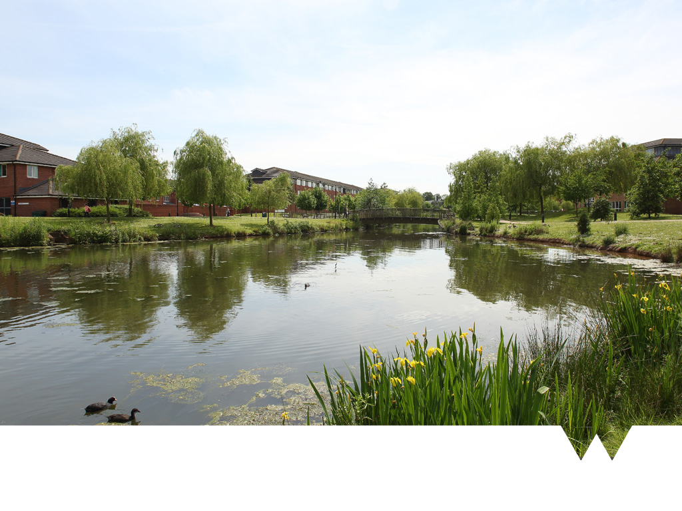
Accommodation
Warwick has one of the largest and widest ranges of campus accommodation in the UK.
Halls of residence, flats and family housing are on campus, with support available for those living off-campus.

Slide 21
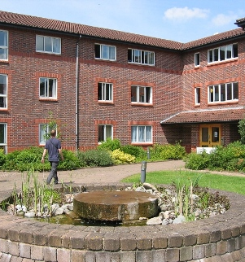
Accommodation: the steps to take
BEFORE YOU APPLY | MAY – JULY | JULY – SEPTEMBER | SEPTEMBER – OCTOBER | OCTOBER ONWARDS
WHERE DO YOU WANT TO LIVE? | APPLICATION | OFFER & CONTRACT | ARRIVAL | RENT
You are here! What hall of residence are you looking for? Explore the options | Complete your application before 31 July! Postgraduates Pay a £250 deposit to secure your place | When to expect your offer Undergraduate September Postgraduate August | Arrival date will depend on student type | First direct debit payment due on 25 October 2015
Notes:
Explain about different halls having different ‘personalities’ and to think carefully about which hall will best suit their needs.
Remind them all accommodation is self catering.

Slide 23
Off-campus accommodation
University Managed
Over 2000 properties available in the local area.
Properties are by popular bus routes with regular services.
No application fees.
Different let lengths available to meet students needs
UG: 42, 46 & 48 week lets
PG: 42, 48 & 50 week lets
Private Sector
Available in the surrounding areas.
Application fees are likely to apply.
You can use the Student Union to check rental agreements before you sign.

Slide 24
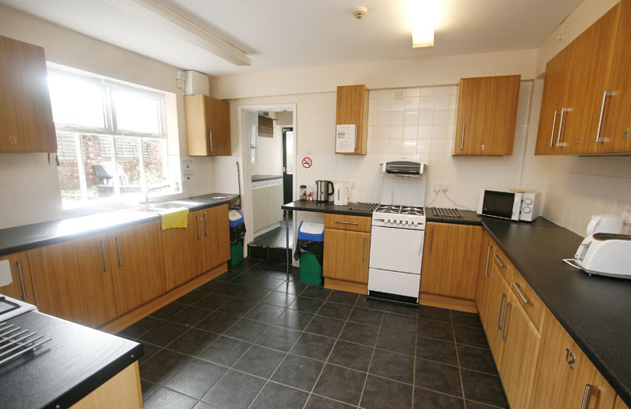
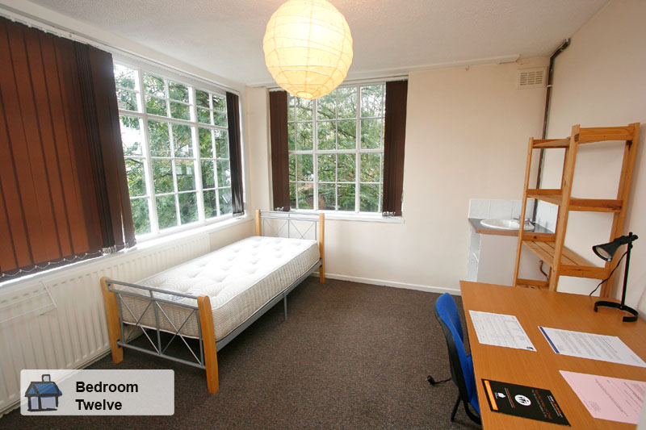
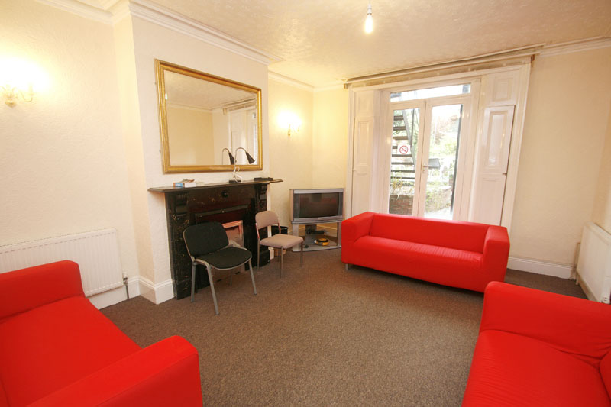
Off-campus accommodation
12 students £81-£86 a week
Notes:
Images of university managed off campus accommodation.

Slide 25
Budgeting
Living cost | Cost | UG total | PG Total
Accommodation (on campus) Accommodation (off campus) | £79 - £153 per week £60 - £90 per week | £3081 - £5967 £2340 - £3510 | £5450 - £7650 £3000 - £4500
Travel (public transport) | £100 per term | £300 | £300
Food and general expenses | £50 - £80 per week | £1950 - £3120 | £2500 - £4000
Books and materials | £450 per year | £450 | £450
Clothing, including additional warm clothing | £450 per year | £450 | £450
Entertainment, laundry, sports, general expenses | £35 per week | £1365 | £1750
Trips and holidays | £10 per week | £390 | £500
Notes:
It is important to ensure you can live within your means, this is a table based on average expenses for students living at Warwick. There are also handy calculators available online to help you

Slide 26
Student Union
Student newspapers, radio stations and TV channels
Many student societies to get involved in (cultural to sporting to academic interest and debating)
Weekly socials
Regular events (tournaments, cultural nights)
Forums
Theatre, cinema, sports facilities, bars & cafes, club nights and live music

Slide 27
Student Societies
We have over 250 societies – the largest number of any Students' Union in the country!
Academic | Activities & Games | Campaigning
Cultural | Film & Media | Food & Drink
Hall Societies | Music Appreciation | Performance & Theatre
Religious | Welfare, Action & Charity
Student
Societies
Notes:
Academic
Activities & Games
Campaigning
Cultural
Film & Media
Food & Drink
Hall Societies
Music Appreciation
Performance & Theatre
Religious
Welfare, Action & Charity

Slide 28
Sport
A training venue for 2012 Olympic Games
Sports facilities include:
60 acres of playing fields
State of the art indoor Tennis Centre
Olympic standard Athletics track
Sports Centre with Swimming Pool,
Sports Halls, Fitness Suite and Bear
Rock Climbing Centre

Slide 29
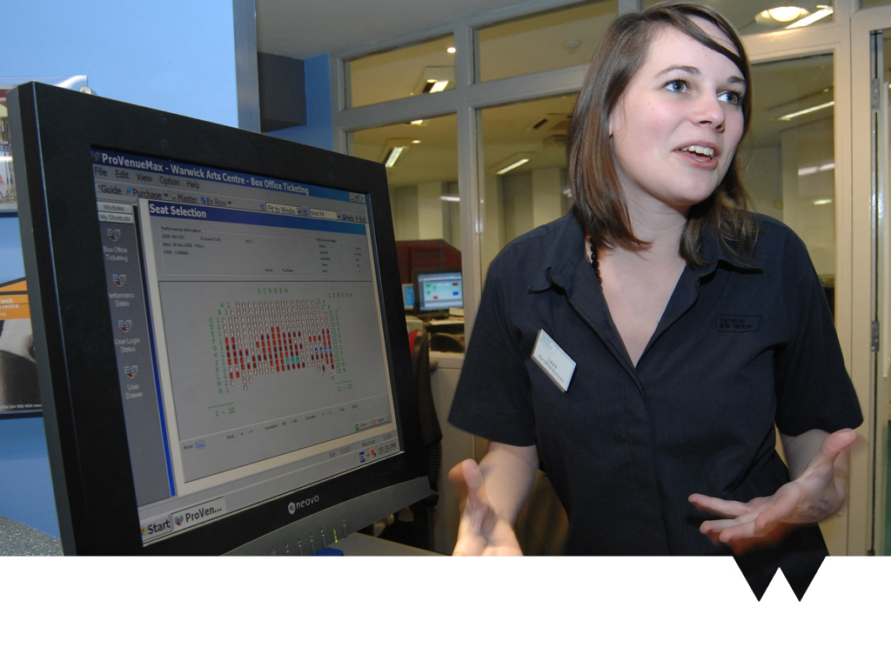
Work during your studies
Jobs can include
Student Union positions
Calling campaigns
Warwick Welcome Service
Academic Departments
Warwick Arts Centre
Local employers outside of the University
Notes:
WWS: (open days, campus tours, schools outreach)
SU can include catering roles
WAC: steward, box office (image on slide) or catering roles
Can be used if you think necessary, however ISB shows students are not happy with job opportunities available to them.

Slide 30
Career support
Warwick graduates are amongst the most sought after by top employers!
The Student Careers and Skills department supports your work skills and learning throughout your whole student experience.
Develop your skills
One to one career consultations
Advice on CV’s applications and interviews
Vacancies database for researching jobs, employers and sectors
Internships and volunteering opportunities
Student careers and skills events, careers fairs and workshops
We prepare graduates for jobs that do not yet exist, who will have to solve problems we do not yet know about.
Notes:
Develop your skills: (academic, personal and professional development opportunities)
Employers come to us regularly to recruit our students due to the unique learning experience here preparing them for work.

Slide 31
International Community
University-wide events
One World Week
Go Global
International Office support
Student experience
Immigration advice
Programmes and Student exchange team
Student Recruitment Team
Notes:
OOW: happens every January. One week of celebrations of culture including fashion shows, dancing, cooking, discussions & talks
Go Global: IO and SU working together with CAL. become an ambassador and promote the different ways students can get a ‘global experience’ at Warwick. Either right here on campus or overseas. Our students went to the Going Global conference this year. (more info needed)

Slide 32
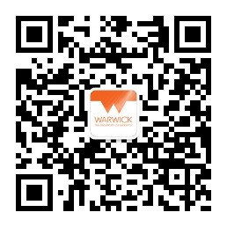
Thank you!
Any Questions?
Please contact:
Warwick Beijing Office
Email: China@warwick.ac.uk
Phone：010 5737 2620
Weibo: @英国华威大学
Wechat：warwickuniversity

