Slide 1
CUFE visit, 2017
David Dickinson
d.g.dickinson@bham.ac.uk
Notes:
1

Slide 2
Welcome
Talk to cover…
The University of Birmingham
Degree programmes
Accommodation
Investments on campus
Sport
Birmingham – The City

Slide 3
Why study Economics in the UK?
Transferable skills
Language
Analytical
Quantitative
Literate
Employability
£££, $$$, €€€

Slide 4
Where to study: Issues to consider
Reputation, History and Tradition
Programmes
Campus facilities
City
Costs
Location

Slide 5
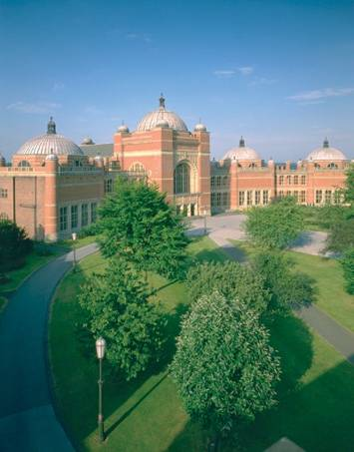
University of Birmingham
Founded 1900 / Russell Group
Universitas 21
Over 4,500 international students from
150 different countries.
The Times Higher Educational (THE) World
University Rankings: 130 in the world (2015)
RAE 2012: 12th in the UK for research excellence
Teaching Quality: Almost 70% students receive first or upper second class degrees
One of the top 6 universities that major companies target

Slide 6
Why study at Birmingham?
The economics department:
40+ academics and 8+ admin staff
Within the Business School
Economics
Management
Accounting and Finance
Marketing

Slide 7
The department
Current Location : JG Smith Building
900+ undergraduate students
300+ MSc students
50+ PhD students

Slide 8
What programmes do we offer?
MSc Economics
MSc International Economics
MSc Development Economics
MSc Environmental and Natural Resource Economics
MSc Mathematical Finance
MSc Financial Economics
MSc International Money and Banking
MSc Money, Banking and Finance

Slide 9
General structure of Postgraduate programmes
120/140 credits taught courses each year
6 modules per term
2 hours of lectures per week for each module
1 or 2 class every 2 weeks
14 contact hours
Which modules?
Core modules: Microeconomics, Macroeconomics Econometrics,
Options

Slide 10
MSc MONEY, BANKING AND FINANCE
Semester 1
Macroeconomics
Econometrics with Financial Applications
International Banking and Finance
Topics in Money and Banking
Semester 2
Risk, Uncertainty and Information
Monetary Policy
Econometrics with Financial Applications
Economics of Financial Markets
Option
Dissertation

Slide 11
Options
International Trade Policy
International Banking: Regulation and Supervision
Development Economic Policy
Political Economy and Economic Policy
Natural Resource Economics
Security Analysis and Portfolio Theory (2
Behavioural and Experimental Economics
The Economics of Corporate Finance

Slide 12
Study methods
Enquiry-based learning
Actively engage in learning process
Research questions
Range of teaching methods
Lectures
Classes
Seminars
Tutorials
Independent learning
Range of assessment
Exams
Assignments

Slide 13
What about assessment?
Most modules have an end-of-year written examination
Most modules will have some elements of continuous assessment
Essays
Class Tests
Marked Problems Sets
Projects

Slide 14
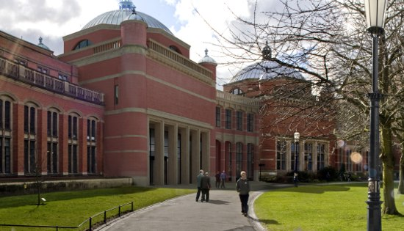
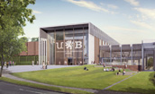
Investing in our campus
£175 million transformation of Edgbaston campus in the next 5 years
Bramall Building opened in 2012 with 450 seat music auditorium

Slide 15
Sport
A sport for everyone
2nd in the British Universities and Colleges Sport (BUCS) League
Athletic Union
Intra-League
Active lifestyles
Notes:
Students can get involved in sports at a level that suits them. At Birmingham we are very proud of our sporting achievements and are currently 2nd in the BUCS League which is a league of UK Universities and Colleges. Students have Wednesday afternoon free and can join sports teams to compete at a high level against other Universities. Alternatively students can play in the Intra-mural league which is a less competitive league between subjects, halls of residence etc.
Intra League is a huge programme of recreational sport within the University. It provides an opportunity to take part in competitive sports without the commitment of training. Emphasis is put on sportsmanship, team spirit, fair play and above all enjoyment.
Active Lifestyles- The University of Birmingham Sport’s programme of fitness classes, is the largest of its kind in the UK and offers such a huge variety of aerobic, toning, holistic and dance classes that students will be spoilt for choice. Active Lifestyle gives everybody an opportunity to get involved in exercise in a fun and friendly environment. Classes are available to suit all levels so you can try something new or develop existing skills.

Slide 16
Campus University
Rated as one of the top 3 campuses in the UK
Located 10 minutes away from the City centre
Very own train station, art gallery, concert hall, Botanical gardens
Open, green spaces
Safe, secure and friendly environment
Investment of £1 million each week on developments

Slide 17
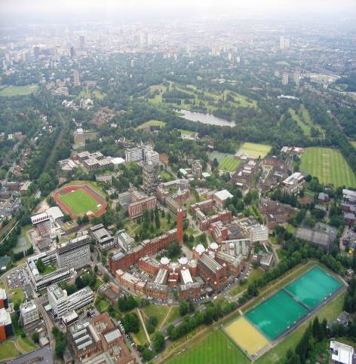
Campus University

Slide 18
Campus facilities
Learning resources
9 open access computer suites, free internet access
13 libraries and resource centres
2.5 million books, 90,000 added each year
Banking
HSBC, Barclays, Lloyds TSB, Santander
Shopping
Supermarket, cafés, bars, hair salon, bookstore
Healthcare
Medical and dental practice, opticians
Sports centre
One of the top 3 universities for sport in the UK
Over 40 different sports
Fitness suite, swimming pool, squash courts, sports hall, athletics track, football pitches
Guild of students
Student societies – over 160
International groups, Film, Debating, sports, chess, human rights
Volunteering – over 100 opportunities (international)

Slide 19
Entry requirements
Undergraduate degree has core Economics modules
Good scores
English IELTS 6.5 no less than 6 in any category (or equivalent)
Potential problems
Adjusting to UK university system
Joining in
Adjusting to UK way of life
Grades
The weather!!!

Slide 20
CUFE co-operation
Deepen relationship
Social Policy and Government & Society
MSc agreement over 5 years
Preparation
Accommodation
Link with administrators
20% discount
Language waiver

Slide 21
And when not studying?
Learn a language:
Subsidized language courses at Language Centre
Dedicated Careers Centre for Birmingham students
Student societies
The Banking Society
The Economics Society
And lots more in the Guild of Students

Slide 22
What sort of careers?
Further degrees in economics or similar (e.g. Birmingham, Cambridge, LSE, UCL, Warwick)
Financial sector (merchant and investment banking, stockbroking, financial analysis, retail banking)
Accounting and Audit (PWC, KPMG etc)
Management consultancy
Government (HM Treasury, ECB, World Bank)
Teaching

Slide 23
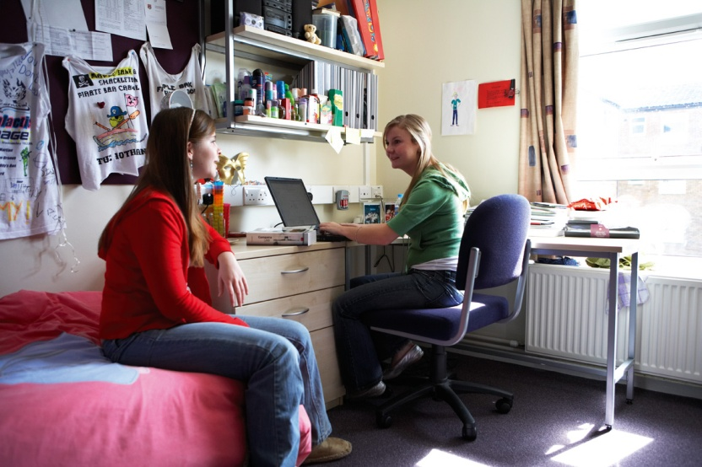
Accommodation
Guaranteed
£70 - £140 per week
Options for:
En Suite/ Shared Bathroom
Catering/ Self Catering
Internet connection
Social Hub
University supported private sector
Notes:
Fresher Guarantee Scheme
The University guarantees a place in university accommodation to those first year undergraduates who want it, subject to the following conditions:
The student must be applying for a University place through the main UCAS scheme (i.e. not through Clearing);
The student must accept our offer firmly and the application for accommodation must be received by Accommodation Services no later than 31 May;
The student must undertake to remain in University accommodation for the whole of their first year.
The University of Birmingham may use 3rd Party Providers e.g. Liberty Living and Victoria Hall as part of the Freshers’ Guarantee Scheme.
Living Taster Days allows future students to view all of the accommodation available to Undergraduate students arriving in 2012 and look around the facilities our student villages have to offer and talk to students currently living there.

Slide 24
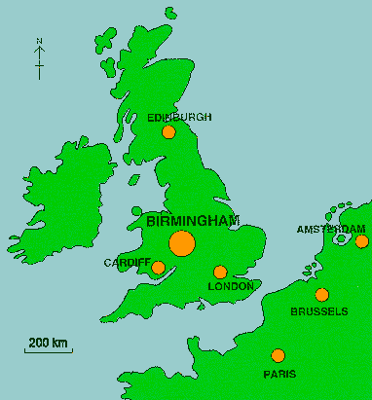
Birmingham City
Vibrant city
First class Arts venues
It is the largest financial and creative district outside London
One of Europe's largest
shopping developments
More then 500 restaurants
Vibrant night life
Host to international sporting events
Sports teams

Slide 25
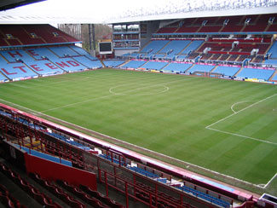
Sports

Slide 26
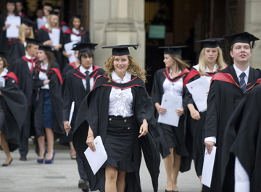
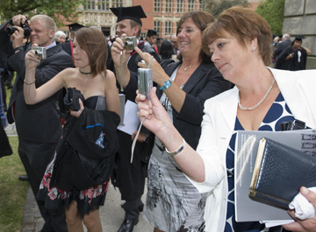
Graduation

